Slide 1
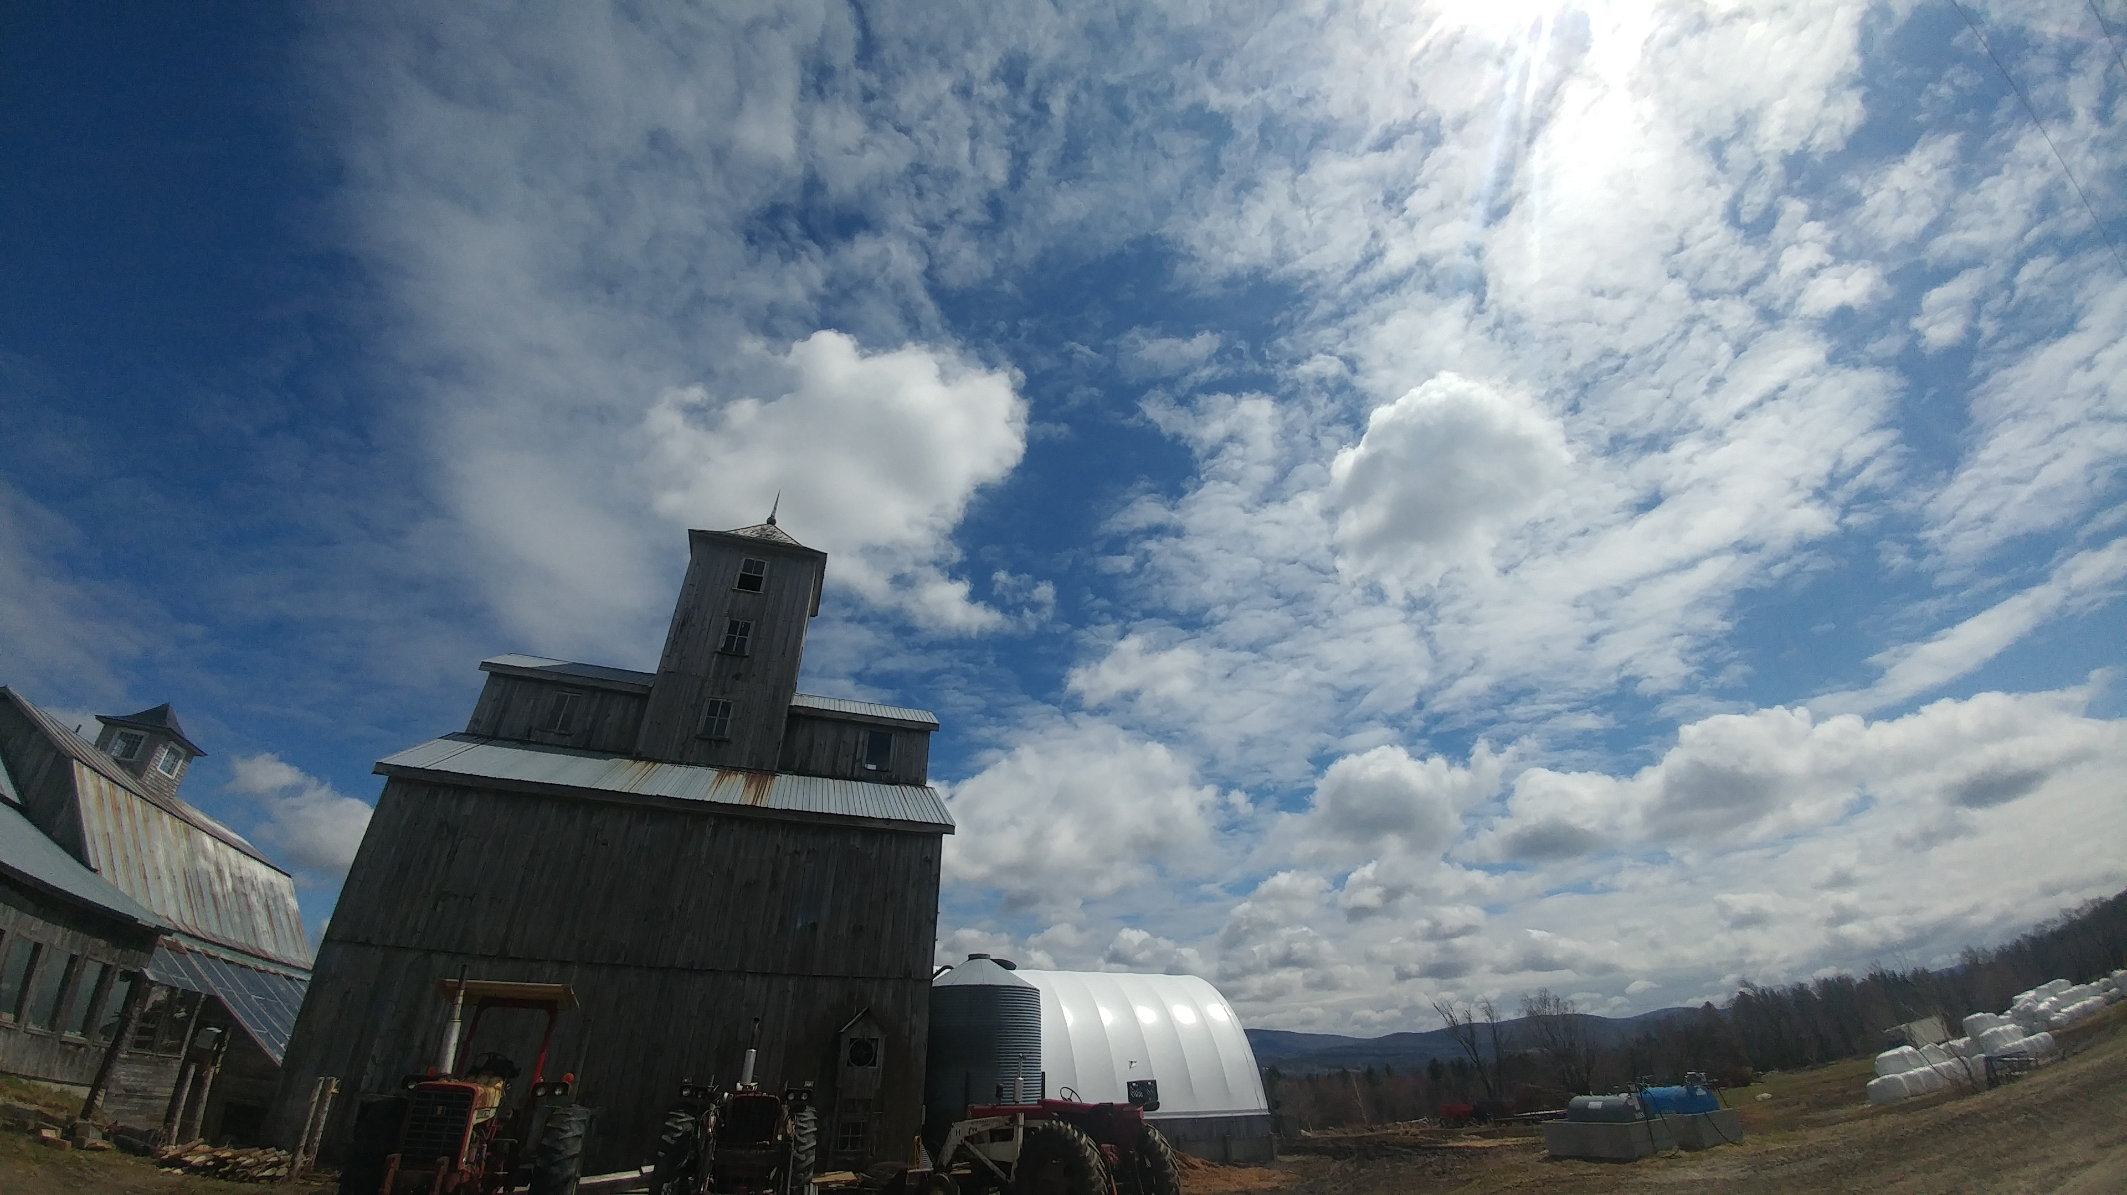
Udder health on organic dairy farms in Vermont: a focus on the epidemiology of staphylococci causing intramammary infections in dairy cattle
Caitlin Jeffrey, DVM
Dissertation presentation, August 26th, 2024
Notes:
Welcome everyone- first off, i want to again thank everyone for taking the time to be here today for my committee meeting- since this will be our first one since May 2022, today I’ll be covering my progress since that point.
Same information as the summary document I emailed around
Open format, as we go through slides can have discussion
If anyone has any questions, input on something, would like further clarification please speak up
So, let’s get started then!

Slide 2
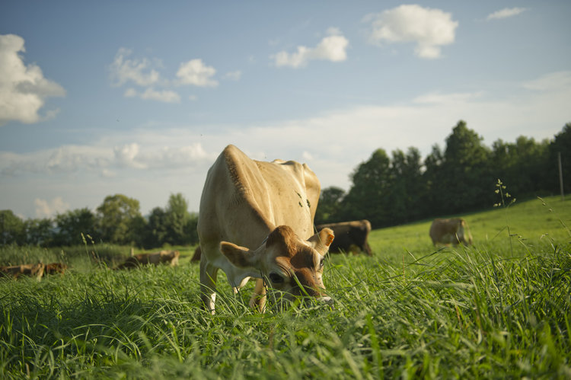
Photo: M. Webb
Udder health on organic dairy farms in Vermont: a focus on the epidemiology of staphylococci causing intramammary infections in dairy cattle
Caitlin Jeffrey, DVM
Dissertation presentation, August 26th, 2024
Notes:
Welcome everyone- first off, i want to again thank everyone for taking the time to be here today for my committee meeting- since this will be our first one since May 2022, today I’ll be covering my progress since that point.
Same information as the summary document I emailed around
Open format, as we go through slides can have discussion
If anyone has any questions, input on something, would like further clarification please speak up
So, let’s get started then!

Slide 3
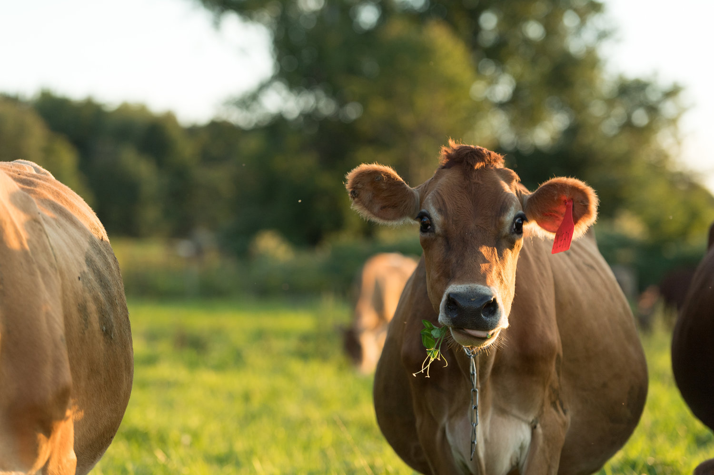
Photo: M. Webb
Udder health on organic dairy farms in Vermont: a focus on the epidemiology of staphylococci causing intramammary infections in dairy cattle
Caitlin Jeffrey, DVM
Dissertation presentation, August 26th, 2024
Notes:
Welcome everyone- first off, i want to again thank everyone for taking the time to be here today for my committee meeting- since this will be our first one since May 2022, today I’ll be covering my progress since that point.
Same information as the summary document I emailed around
Open format, as we go through slides can have discussion
If anyone has any questions, input on something, would like further clarification please speak up
So, let’s get started then!

Slide 4
General organic background

Slide 5
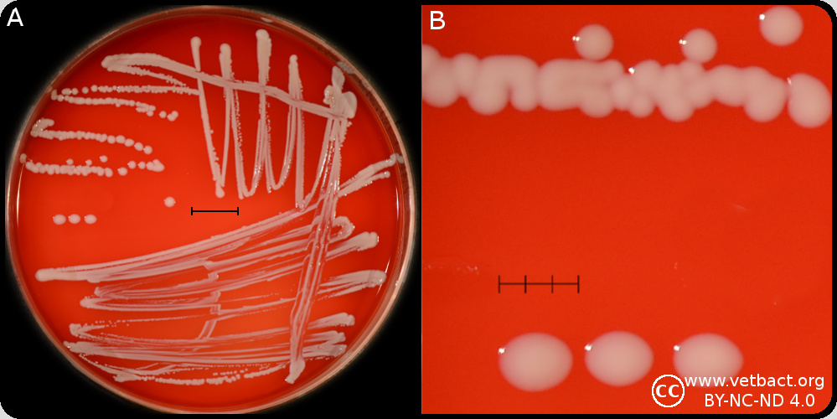
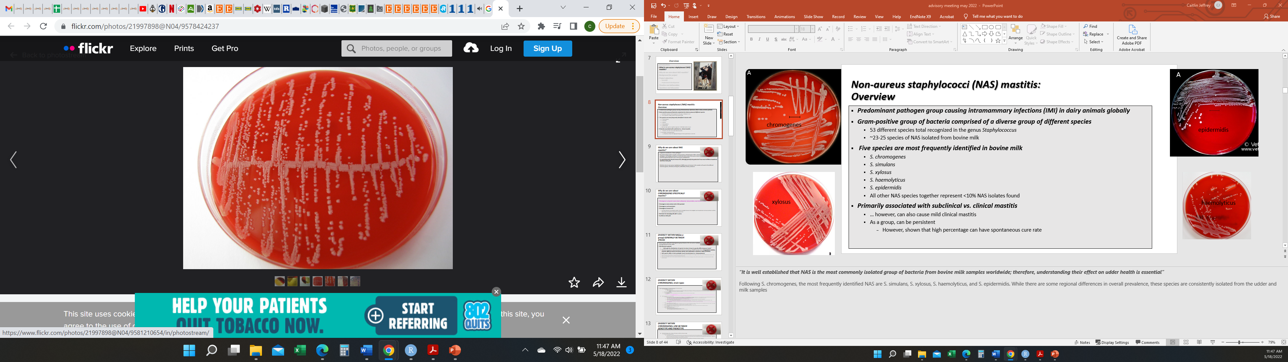
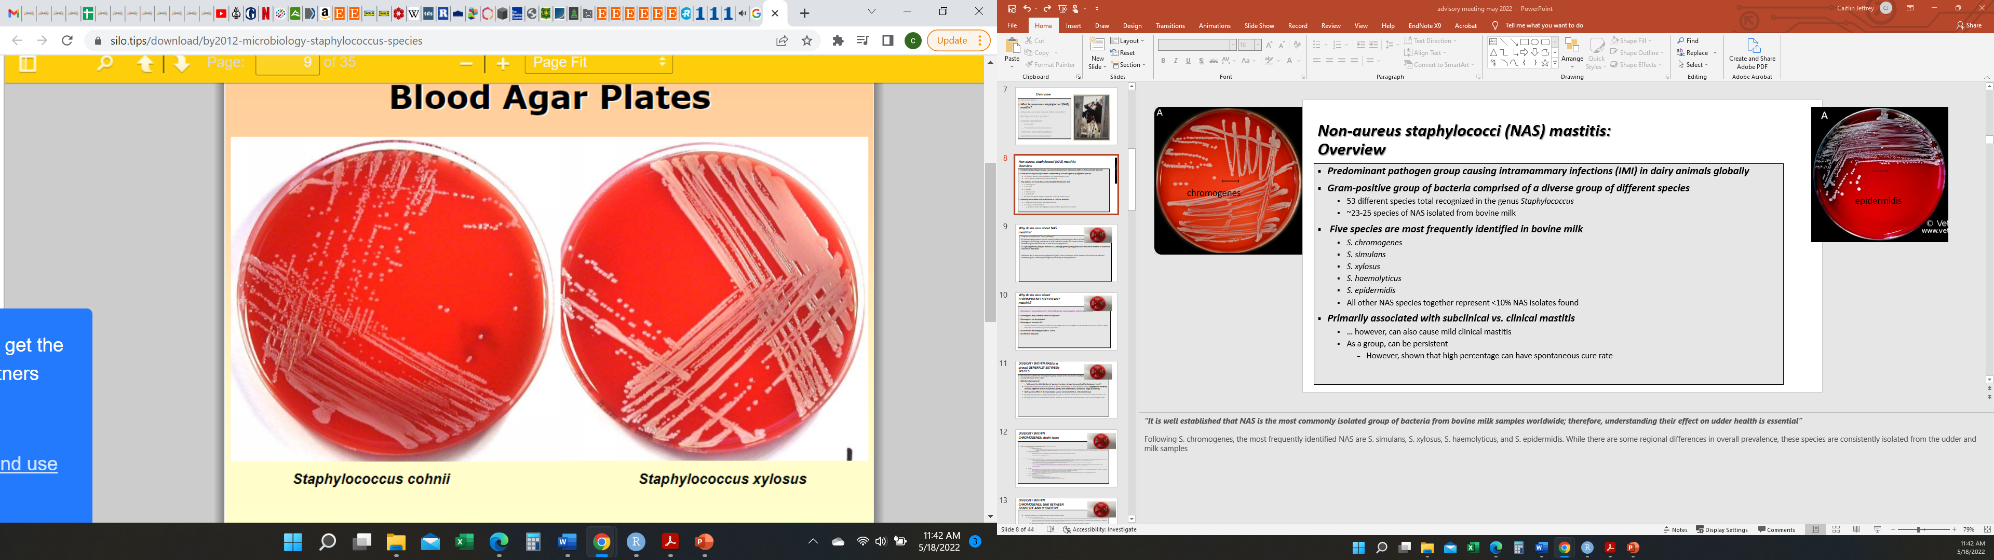
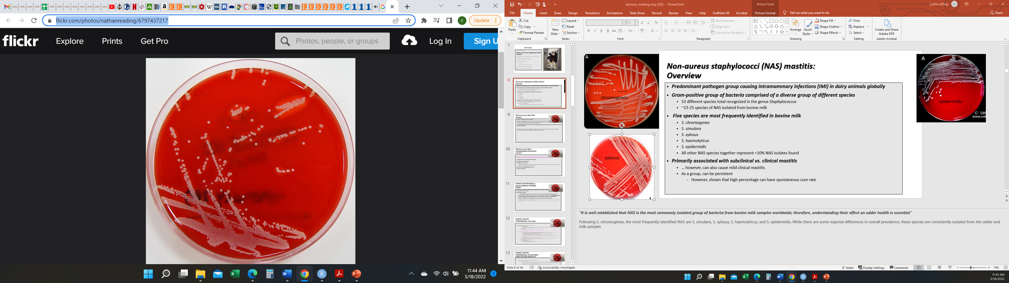
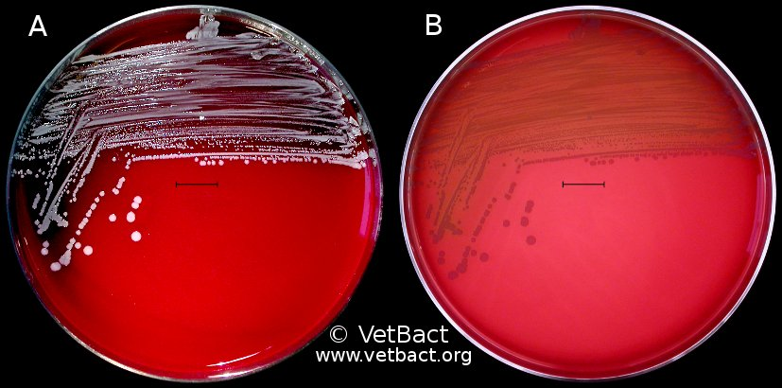
Non-aureus staphylococci and mammaliicocci (NASM) mastitis: Overview
Predominant pathogen group causing intramammary infections (IMI) in dairy animals globally
Gram-positive group of bacteria comprised of a diverse group of different species
53 different species total recognized in the genus Staphylococcus
~23-25 species of NAS isolated from bovine milk
Five species are most frequently identified in bovine milk
S. chromogenes
S. simulans
S. xylosus
S. haemolyticus
S. epidermidis
All other NAS species together represent <10% NAS isolates found
Primarily associated with subclinical (vs. clinical) mastitis
… however, can also cause mild clinical mastitis
As a group, can be persistent
However, shown that high percentage can have spontaneous cure rate
Notes:
“It is well established that NAS is the most commonly isolated group of bacteria from bovine milk samples worldwide; therefore, understanding their effect on udder health is essential”
Following S. chromogenes, the most frequently identified NAS are S. simulans, S. xylosus, S. haemolyticus, and S. epidermidis. While there are some regional differences in overall prevalence, these species are consistently isolated from milk samples

Slide 6
Non-aureus staphylococci and mammaliicocci (NASM) mastitis: Why do we care?
Long been considered a “minor pathogen”
NAS as a group increase somatic cell count (SCC)
although generally, subclinical NAS intramammary infections don’t have much effect on milk yield
Many farms have implemented modern mastitis control practices minimizing the effects of bacteria considered to be “major” pathogens
Well-described, effective control practices based on thorough understanding of “major” mastitis pathogens
Staphylococcus aureus, Streptococcus agalactiae
The leading contributor to bulk tank milk somatic cell count on farms with good milk quality is mammary gland infections due to non-aureus staphylococci
Notes:
… Infections due to non-aureus staphylococci (NAS) DO cause an increase in the somatic cell count in the affected mammary gland
Many farms have implemented modern mastitis control practices minimizing the effects of bacteria considered to be “major” pathogens
Well-described, effective control practices based on through understanding of major mastitis pathogens
the quintessential examples of this are the organisms Staphylococcus aureus, Streptococcus agalactiae
this has lead to the leading contributor to bulk tank milk somatic cell count on farms with good milk quality now is mammary gland infections due to non-aureus staphylococci; ultimately hurting the profitability of dairy producers

Slide 7
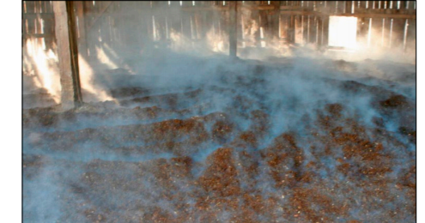
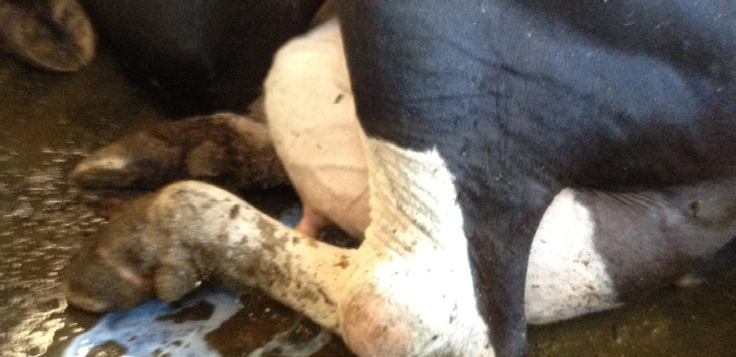
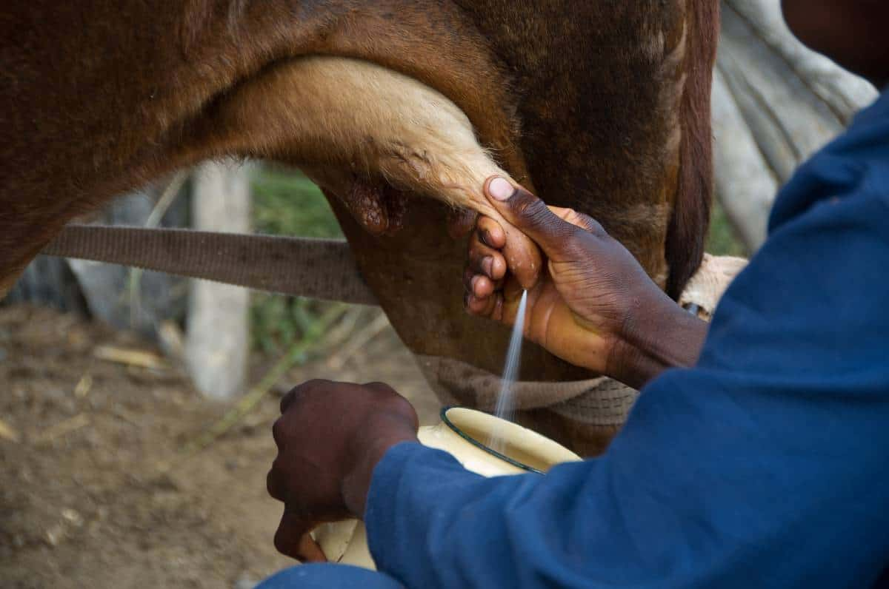
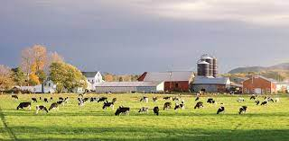
Non-aureus staphylococci and mammaliicocci (NASM) mastitis: Diversity between species
Extremely heterogenous group of bacteria
NAS species differ from each other in how they behave as an intramammary pathogen
Ability to cause persistent infections
Effect on milk yield
Degree to which they cause an inflammatory reaction in the udder (measured by quarter SCC)
NAS species differ in their virulence potential (ability for host invasion and tissue damage)
Antimicrobial resistance pattern
Interaction with host’s immune system
Factors associated with NAS diversity
Both distribution of species and prevalence greatly differ between herds
Geographical and seasonal variation
Animal-level factors (parity, teat confirmation, cleanliness, stage of lactation)
Probable source (environment, intramammary, skin)
Notes:
Not all species within this heterogenous group known as the non-aureus staphylococci behave the same while causing infections of the udder
NAS species differ from each other in how they behave as an intramammary pathogen.. different species vary in their
Ability to cause persistent infections
Effect on milk yield
Degree to which they cause an inflammatory reaction in the udder (measured by quarter SCC)
NAS species also differ in their virulence potential (ability for host invasion and tissue damage)
antimicrobial resistance pattern, and interaction with a host’s immune system

Slide 8
General staph background

Slide 9
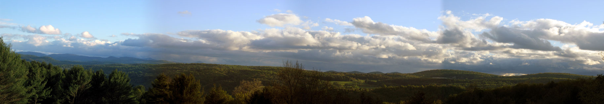
Specific objectives, Project 1:
1) Characterize the quarter-level prevalence of intramammary infections caused by different microorganisms for organic dairies farms in Vermont using two different facility types:
-Tiestalls with shavings, bedded pack systems
Notes:
the specific objectives for this project are to:
identify the incidence, elimination, and prevalence of NASM IMI (generally, as a group) and for the most frequently-found NASM species, and
identify if infection risk is associated with various herd-, cow-, and quarter-level predictors for both NASM generally (as a group), and the most frequently-found NASM species through a model-building approach

Slide 10

Methods: Study overview
Organicvalley.coop
Photo: M. Webb
Inclusion criteria for herds:
Certified organic dairy
Milking between 35 and 120 cows
Utilizing a tiestall with shavings OR a bedded pack system
Notes:
For inclusion criteria, the farms we enrolled needed to be…
And using either… FOR their WINTER HOUSING system, as most of these herds are primarily pasture-based during the grazing season
Which we had previously identified as the range that the majority of organic dairies in Vermont fall within to reduce variation from outliers, limit 10th-90th quantiles
Enrolled farms were a non-probability subsample of certified organic dairies in Vermont which had participated in previous studies, and inclusion criteria included: 1) milking between 35-120 cows and 2) using either a tiestall barn bedded with shavings/sawdust or a deep bedded pack system to house lactating dairy cows.

Slide 11
Methods: Study overview
Organicvalley.coop
M. Webb
Inclusion criteria for herds:
Certified organic dairy
Milking between 35 and 120 cows
Utilizing a tiestall with shavings OR a bedded pack system
Notes:
For inclusion criteria, the farms we enrolled needed to be…
And using either… FOR their WINTER HOUSING system, as most of these herds are primarily pasture-based during the grazing season
Which we had previously identified as the range that the majority of organic dairies in Vermont fall within to reduce variation from outliers, limit 10th-90th quantiles
Enrolled farms were a non-probability subsample of certified organic dairies in Vermont which had participated in previous studies, and inclusion criteria included: 1) milking between 35-120 cows and 2) using either a tiestall barn bedded with shavings/sawdust or a deep bedded pack system to house lactating dairy cows.

Slide 12
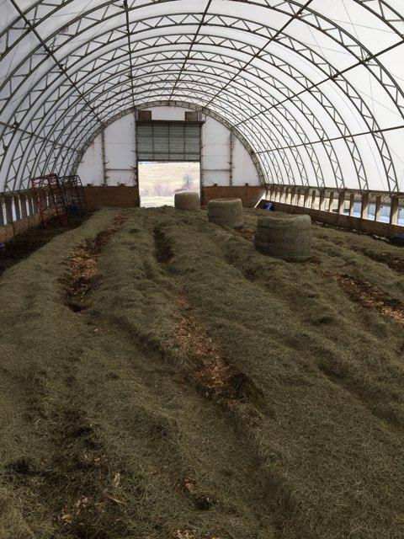
Methods: Facility types
Bedded pack systems
Compost bedded-pack vs. static/traditional/deep bedded pack
Loose housing
Deeply bedded with organic material
Advantages
Affordable option when updating facilities
Improved cow comfort/decreased lameness
Integrate well with pasture-based farms
Welfare concerns
Manure management
Notes:
Just a quick aside to introduce a type of facility for housing dairy cattle which may be less familiar to some people…
The term “bedded pack” can encompasses a variety of management styles, including compost bedded-packs (CBP), which utilize aerobic decomposition to break down a bedding material of fine wood sawdust or shavings, as well as “conventional,” “traditional,” or “deep bedded packs.” In the Northeastern U.S., some producers are using deep bedded pack systems where large volumes of straw or hay are added daily to an untilled surface and strata of bedding and waste accumulate throughout winter season
For the purposes of this study, the inclusive term “bedded pack” is used to encompass both CBP and deep bedded packs, and was defined as an enclosed loose housing facility deeply bedded with organic material, in which bedding and waste accumulate throughout the 6–8-month period of time when cows are housed on it and which is only removed once a year. Both CBP and deep bedded packs use carbon-rich substrates to create a clean, comfortable surface which allows animals to move freely. Urine and manure are not removed when bedding material is renewed, in contrast with other housing systems.

Slide 13
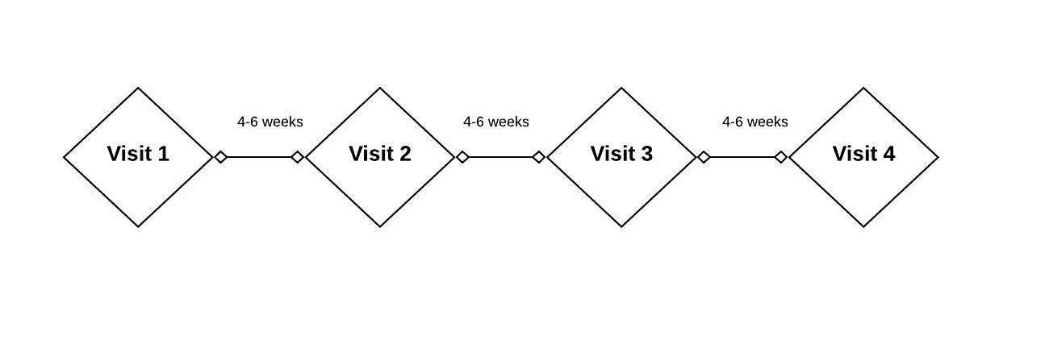
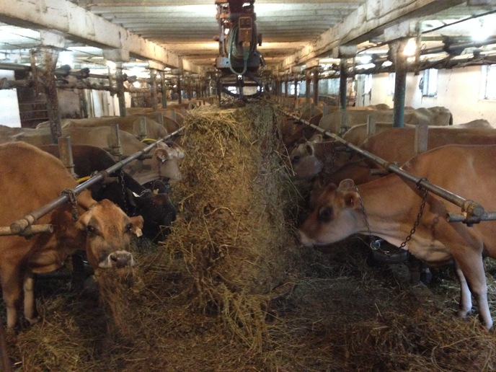
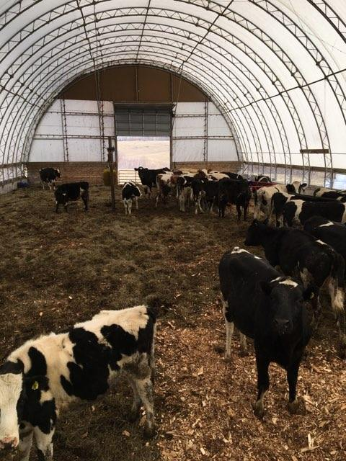
Methods: Sample collection
10 organic dairies
4 samplings/farm
35 cows per farm visit
Duplicate quartermilk samples
Notes:
This data comes from a longitudinal study of 10 certified organic dairy farms in Vermont carried out in Winter 2019-2020.
The goal was to sample each herd 4 times, with 4-6 weeks elapsing between each farm visit.
From each of the 10 enrolled herds, thirty-five lactating cows of varying parity in early- to mid-lactation were chosen at random to be sampled for the duration of the study. At each farm visit, duplicate quarter milk samples were aseptically collected from each lactating quarter immediately before milking for all enrolled cows. Around the time of the first farm visit, herd records were captured from the record processing center working with 9 of the participating herds (Lancaster DHIA, Manheim, PA; Dairy One Co-Op. Inc., Ithaca, NY) to obtain freshening date and parity for the current lactation. Freshening date and parity for 1 herd was obtained from personal communication with the producer who kept written records.

Slide 14
Methods: Overview of enrolled farms
Notes:
Here’s an overview of our 10 enrolled herds. The median number of lactating cows was 59 (range: 39-77), with a variety of breeds represented. There were 5 farms using a tiestall facility, and 5 farms where cows were housed on a bedded pack. You can see that the weighted average somatic cell count from the last test date prior to starting the study ranged pretty widely between the enrolled herds,
Five farms housed cows in a tiestall bedded with wood shavings, and 5 utilized a deep bedded pack system (3 actively managed for composting by tilling, 2 static/deep-bedded).
[The average SCC of the lactating cows in the herd is adjusted (weighted) to account for level of milk production – so a cow making a lot of high cell count milk contributes more to the average than a cow making a lower volume of milk but with the same milk SCC]
Rolling Herd Average for milk production represents the average amount of milk produced by the average cow in the herd for the last 365 days.

Slide 15
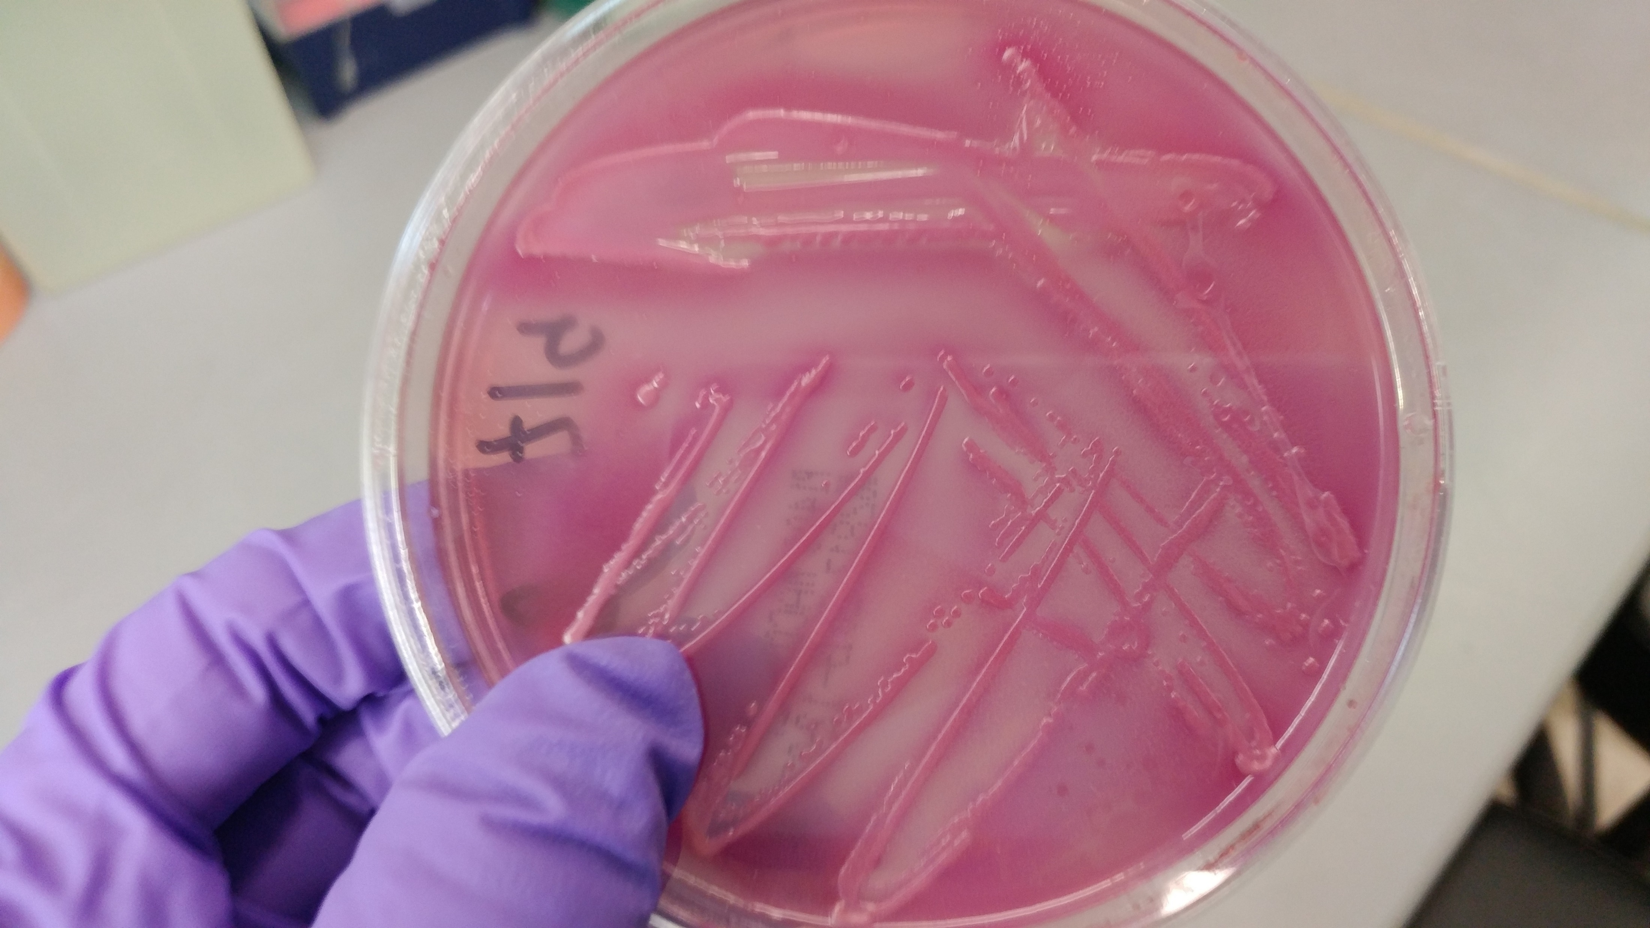
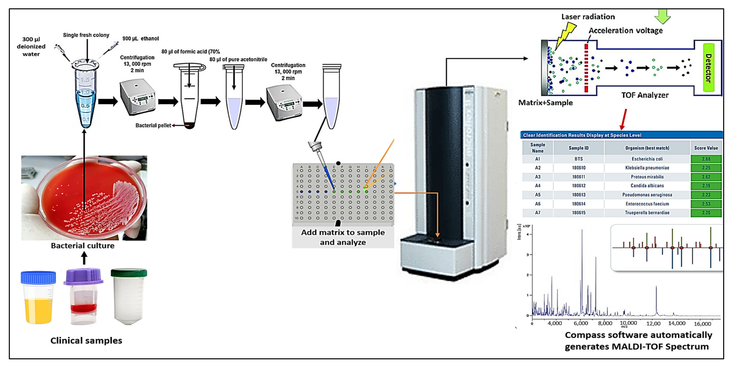
Methods: Bacteriological culture
Quarter milk samples plated in duplicate
Quarter-level SCC by flow cytometry
Presumptive benchtop identification of IMI pathogens
Further identification by MALDI-ToF (Adkins Lab, U. Missouri College of Vet. Med.)
Elbehiry et al., 2022
Notes:
After every farm visit, standard aerobic bacteriological culture of quartermilk samples was performed in duplicate to identify intramammary infections; additionally, an aliquot was frozen for submission to the state agricultural lab for quarter-level somatic cell count using flow cytometry
Bacteria deemed to be causing IMI were first presumptively identified based on morphology, hemolytic pattern, and standard bench-top diagnostic methods, and then sent to the Adkin’s lab in Missouri for further identification using MALDI-ToF
A quarter was considered positive for an IMI when greater than or equal to 1 CFU was identified with the same morphology for both duplicate samples, and negative when there was no significant growth in that quarter on either duplicate plate.
plated 10 uL milk; would be equivalent to 100 CFU/mL

Slide 16
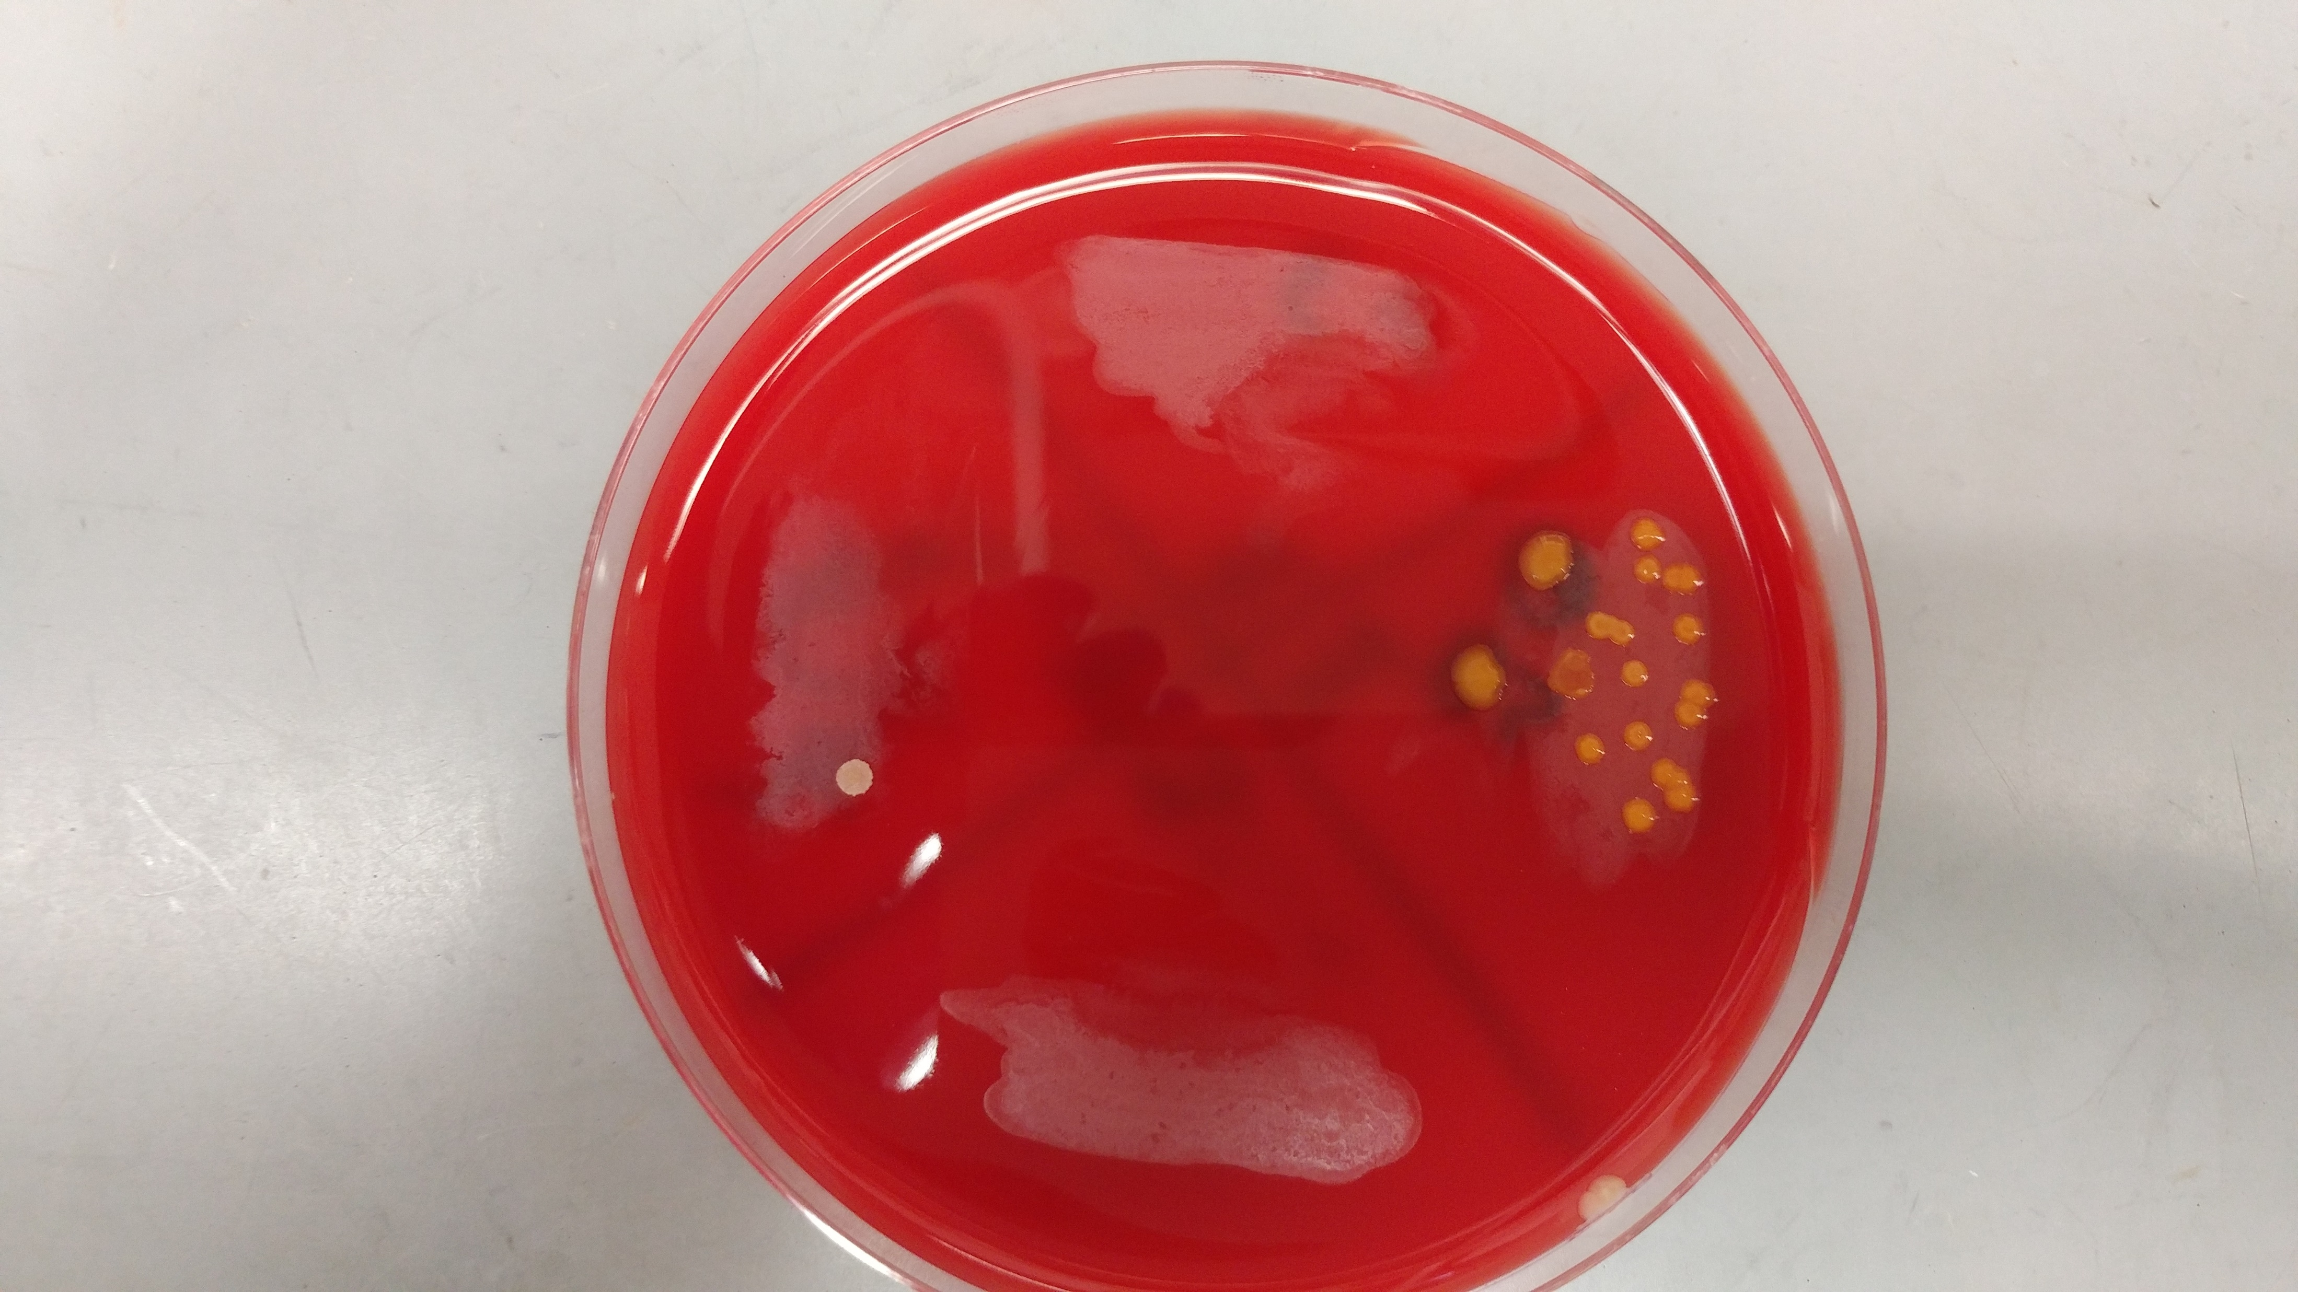
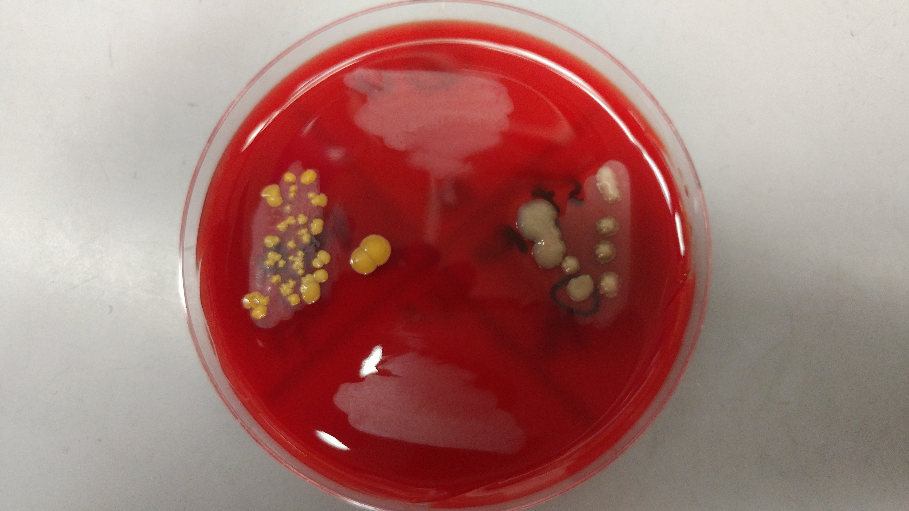
Methods: Data analysis
Assign status to quarter observation
1) No growth
2) Single pathogen infection
3) Mixed infection
4) Unknown
Descriptive analysis of quarter-level prevalence
By visit for each farm
For TS vs. FS
Overall
Notes:
Descriptive analysis for short communication
Using the bacteriological status and species identification, a quarter-day IMI status was assigned to each quarter observation: 1) “healthy,” when there was no significant growth; 2) “single pathogen infection,” when ≥ 100 CFU/mL of a particular pathogen was identified in pure culture on both plates, 3) “mixed infection,” when ≥ 100 CFU/mL of 2 different pathogens were identified in mixed culture on both plates; and 4) “unknown” “contaminated,” when ≥ 1 of the 2 samples had more than 2 morphologically distinct isolates growing on a plate; 5) and “indeterminate,” when the set of quarter-milk samples did not meet the criteria for any of the previous categories (e.g., missing duplicate). A quarter-day observation was included in the final data set if the IMI status was classified as no growth, single pathogen infection, or mixed infection.
Quarter-day IMI status, cow information, visit, and herd data were organized into a spreadsheet and imported into the R Statistical Programming Environment for analysis. The quarter-level prevalence for each farm visit was calculated by dividing the number of quarters infected with a particular pathogen (or grouping of similar pathogens) by the total number of sampled quarters at risk where IMI status could be determined for that farm visit. Median and range of quarter-level prevalence for each herd was then calculated using all consecutive visits to a particular farm. Median and range of quarter-level prevalence for tiestalls and bedded packs were calculated over all 15 visits to each facility type, respectively. Overall median and range of quarter-level prevalence were calculated using all 30 visits to the 10 farms.

Slide 17
Table 1. Quarter-level prevalence of the six most common pathogens (or grouping of similar pathogens) causing intramammary infections [median (range)] by farm, stratified by facility type. 3,332 quarter-level observations were collected from 1,456 quarters belonging to 382 cows during a longitudinal, cross-sectional observational study of 10 certified organic dairy farms in Vermont (US). The quarter-level prevalence represents the percent of sampled quarters infected with a particular pathogen over all sampled quarters at risk where IMI status could be determined for that farm visit. Median and range of quarter-level prevalence for each herd were calculated using all consecutive visits to a particular farm. Median and range of quarter-level prevalence for tiestalls (TS) and bedded packs (BP) were calculated over all visits to TS (n = 15) and BP (n = 15), respectively. Overall median and range of quarter-level prevalence were calculated using all visits to all 10 farms (n = 30).
 |  | TS-1 | TS-2 | TS-3 | TS-4 | TS-5 | TS avg. | BP-1 | BP-2 | BP-3 | BP-4 | BP-5 | BP avg. | Overall
Num. farm visits |  | 3 | 3 | 3 | 3 | 3 | 15 | 3 | 4 | 3 | 2 | 3 | 15 | 30
Pathogen (group)
 | Non-aureus staphylococci and mammaliicocci | 10 (9.7-10.4) | 19.6 (16.7-23.2) | 24 (22.3-25.6) | 15.8 (14.2-18.5) | 20.4 (19-24.5) | 19 (9.7-25.6) | 24.8 (21.9-39.8) | 14.1 (12.8-18.2) | 23.6 (21.9-25.5) | 19.4 (17.6-21.1) | 20.6 (19.4-22.4) | 21.1 (12.8-39.8) | 20 (9.7-39.8)
 | Streptococcus uberis | 1 (0.9-1) | 5.6 (5-6.1) | 5 (4-5.1) | 2.4 (2.4-2.6) | 0.9 (0.9-1) | 2.4 (0.9-6.1) | 3.6 (3.2-5.5) | 4.2 (1.1-6.1) | 2.4 (1.8-3.5) | 0.4 (0-0.8) | 5.3 (4-5.6) | 3.6 (0-6.1) | 3.4 (0-6.1)
 | Staphylococcus aureus | 3.5 (3.1-4) | 1.9 (1.7-2.4) | 4 (3.4-4.1) | 3.5 (3.2-3.9) | 0.9 (0.9-1) | 3.2 (0.9-4.1) | 4.8 (4.7-8.4) | 13.1 (11.7-14.1) | 0.8 (0-2.6) | 1.3 (0.9-1.7) | 0.8 (0-0.8) | 2.6 (0-14.1) | 3.2 (0-14.1)
 | Corynebacterium spp.¹ | 4 (0.9-6.3) | 7.5 (6.7-11) | 2.4 (0.8-2.6) | 1.6 (0-1.6) | 0 (0-0.9) | 1.6 (0-11) | 0.8 (0-8.4) | 11.5 (5.3-20.2) | 0 (0-0) | 0.4 (0-0.8) | 0 (0-0) | 0 (0-20.2) | 0.9 (0-20.2)
 | Other gram-positive bacteria | 1 (0.9-1) | 0 (0-1.2) | 0.8 (0-0.8) | 0.8 (0-1.6) | 0 (0-1.8) | 0.8 (0-1.8) | 0.8 (0-0.8) | 2.1 (1-4.3) | 0 (0-0) | 1.3 (0.8-1.8) | 0.8 (0-0.8) | 0.8 (0-4.3) | 0.8 (0-4.3)
 | Streptococcus dysgalactiae | 0 (0-0) | 3.3 (2.8-7.3) | 1.7 (0.8-1.7) | 0.8 (0.8-0.9) | 0 (0-0) | 0.8 (0-7.3) | 0 (0-0) | 1.6 (1.1-2) | 0.9 (0-1.8) | 0 (0-0) | 0 (0-0) | 0 (0-2) | 0.4 (0-7.3)
¹Corynebacterium sp. (genus-level identification only), C. amycolatum, C. callunae, C. casei, C. confusum, C. glutamicum, C. stationis, C. ulcerans, C. variabile, C. xerosis

Slide 18
Table 2. Quarter-level prevalence of seven most common non-aureus staphylococci and mammaliicocci (NASM) causing intramammary infections [median (range)] by farm, stratified by facility type. 3,332 quarter-level observations were collected from 1,456 quarters belonging to 382 cows during a longitudinal, cross-sectional observational study of 10 certified organic dairy farms in Vermont (US). The quarter-level prevalence represents the percent of sampled quarters infected with a particular pathogen over all sampled quarters at risk where IMI status could be determined for that farm visit. Median and range of quarter-level prevalence for each herd were calculated using all consecutive visits to a particular farm. Median and range of quarter-level prevalence for tiestalls (TS) and bedded packs (BP) were calculated over all visits to TS (n = 15) and BP (n = 15), respectively. Overall median and range of quarter-level prevalence were calculated using all visits to all 10 farms (n = 30).
 |  | TS-1 | TS-2 | TS-3 | TS-4 | TS-5 | TS avg. | BP-1 | BP-2 | BP-3 | BP-4 | BP-5 | BP avg. | Overall
Num. farm visits |  | 3 | 3 | 3 | 3 | 3 | 15 | 3 | 4 | 3 | 2 | 3 | 15 | 30
NASM species
 | Staphylococcus chromogenes | 6 (5.3-6.3) | 13.1 (11.7-15.9) | 16.2 (14.9-16.8) | 8.8 (7.1-8.9) | 15.5 (13.8-15.5) | 13.1 (5.3-16.8) | 15.2 (13.3-21.7) | 7.8 (6.5-10.1) | 19.5 (17.5-21.8) | 15.9 (14.3-17.4) | 16.8 (16.1-17.6) | 16.1 (6.5-21.8) | 14.6 (5.3-21.8)
 | Staphylococcus haemolyticus | 1 (0.9-1) | 0 (0-0) | 0.8 (0.8-1.7) | 1.6 (1.6-1.8) | 0 (0-0.9) | 0.9 (0-1.8) | 3.1 (2.4-4.8) | 3 (2.1-3.3) | 3.3 (2.7-3.5) | 0.9 (0.8-0.9) | 0.8 (0-1.9) | 2.7 (0-4.8) | 1.3 (0-4.8)
 | Staphylococcus simulans | 1 (0.9-1) | 0 (0-0) | 3.2 (2.5-4.3) | 3.2 (3.1-3.5) | 0 (0-0) | 1 (0-4.3) | 2.4 (2.3-2.4) | 0 (0-0) | 0.9 (0.8-0.9) | 0.9 (0.8-0.9) | 1.5 (0.8-1.9) | 0.9 (0-2.4) | 0.9 (0-4.3)
 | Staphylococcus equorum | 0 (0-0) | 3.7 (1.7-3.7) | 0 (0-0) | 0 (0-0) | 1 (0.9-1.7) | 0 (0-3.7) | 0 (0-1.2) | 0 (0-1.1) | 0 (0-0) | 0 (0-0) | 0 (0-0) | 0 (0-1.2) | 0 (0-3.7)
 | Staphylococcus agnetis | 2 (1.8-2.1) | 0 (0-0) | 0 (0-0.8) | 0 (0-0) | 0 (0-0.9) | 0 (0-2.1) | 2.4 (0.8-3.6) | 1.1 (0-2) | 0 (0-0) | 0.9 (0.8-0.9) | 0.8 (0.8-0.9) | 0.8 (0-3.6) | 0.8 (0-3.6)
 | Staphylococcus devriesei | 0 (0-0) | 0.9 (0.8-1.2) | 0 (0-0) | 0 (0-0) | 1.9 (1.7-2.7) | 0 (0-2.7) | 0.8 (0.8-2.4) | 1 (0-1.1) | 0 (0-0) | 0 (0-0) | 0 (0-0) | 0 (0-2.4) | 0 (0-2.7)
 | Staphylococcus warneri | 0 (0-0) | 0 (0-0) | 2.5 (2.4-2.6) | 1.6 (1.6-1.8) | 0 (0-0) | 0 (0-2.6) | 1.6 (0.8-2.4) | 0 (0-0) | 0 (0-0) | 0 (0-0) | 0 (0-0) | 0 (0-2.4) | 0 (0-2.6)

Slide 19
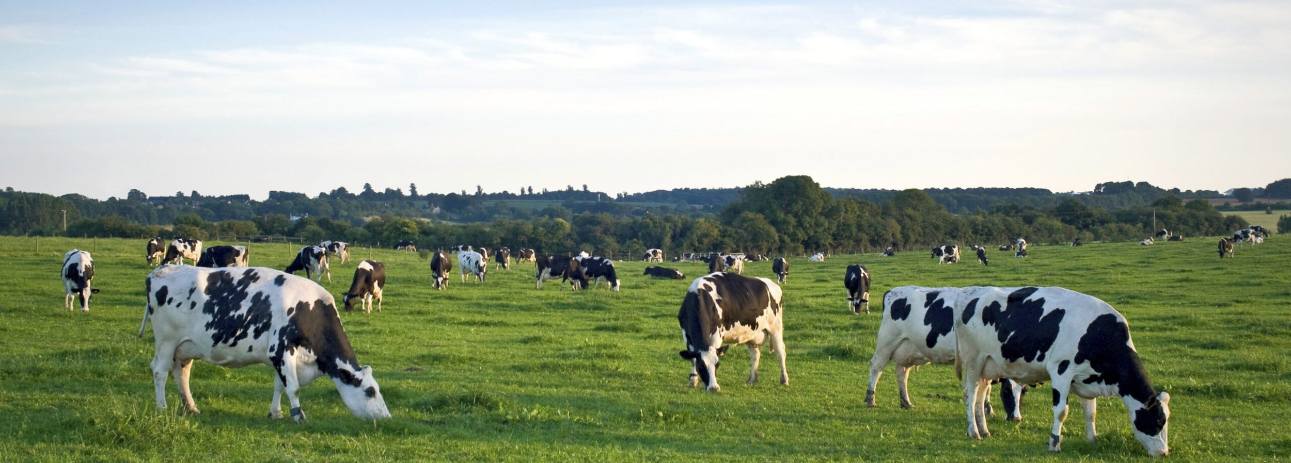
Link project 1 to project 2
thedairyalliance.com
Introduce the term SaM
Notes:
Species from the genus Staphylococcus were responsible for the majority of mastitis in these herds. S. chromogenes was the most frequently found, followed by S. aureus. The diversity of staphylococcal species observed and the species-level effect on inflammatory reaction (as measured by somatic cell count, or SCC) was similar to conventional herds. Compared to healthy quarters, SCC was higher in quarters infected with nine of 10 staphylococcal species identified. Although increase in SCC was modest for most staphylococcal species, their widespread nature can still result in sizeable increases in bulk tank SCC.

Slide 20
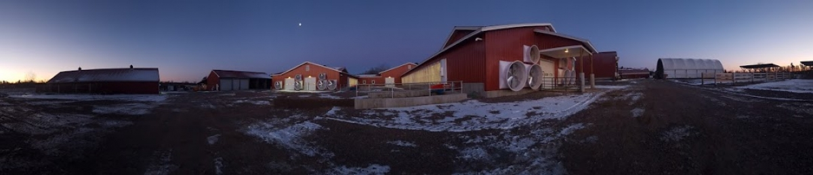
Specific objectives, Project 2:
1) Describe how quarter-milk somatic cell count varied as a result of infection with the most frequently isolated staphylococci and mammaliicocci (SaM), in order to identify which species are more relevant to udder health for organic farms

Slide 21
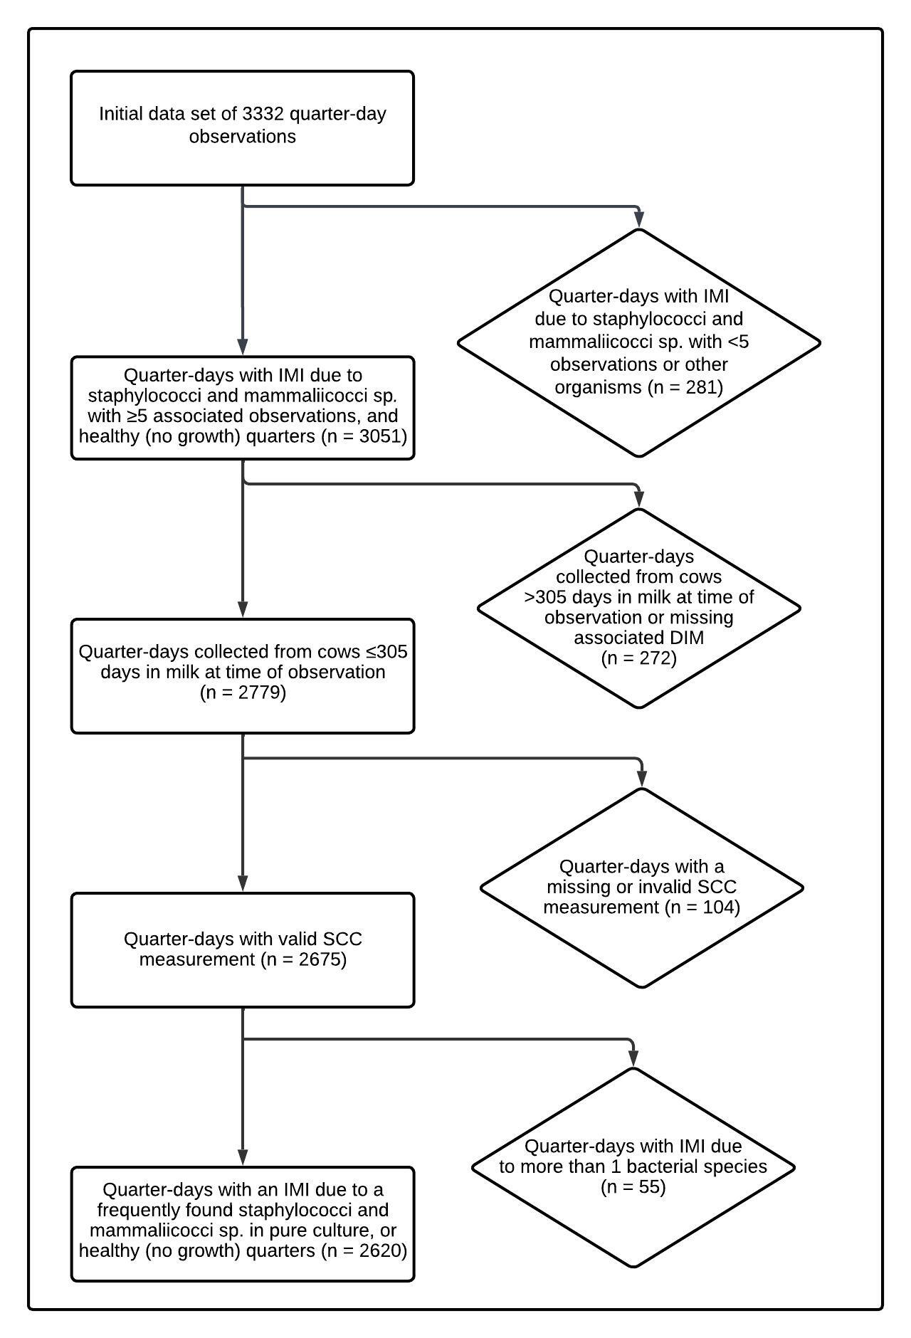
Methods: Data set selection
Assign status to quarter observation
1) No growth
2) Infected with a single SaM species
3) Infected with two SaM species
4) Infected with non-SaM species
5) Unknown
Notes:
Using the bacteriological status and speciation information, a quarter-day IMI status was assigned to each quarter observation: 1) “healthy,” when there was no significant growth; 2) “infected with a single SaM species,” when ≥ 100 CFU/mL of a particular SaM species was identified in pure culture on both plates; 3) “infected with 2 SaM species,” when ≥ 100 CFU/mL of 2 different SaM species were identified in mixed culture on both plates; 4) “infected with non-SaM species,” when ≥ 100 CFU/mL of a non-SaM species was identified in pure or mixed culture on both plates (possibly in combination with a SaM species); and 5) “unknown” if the sample status had been identified as contaminated or indeterminate as previously described.
A quarter-day observation was included in the final data set if: 1) the IMI status was classified as healthy or infected with a single SaM species for any of the most frequently observed SaM species (≥ 5 observed IMI); 2) it was collected from a cow ≤ 305 DIM at time of observation; and 3) it had an associated quarter-level SCC measurement. Figure 1 depicts the selection of the final data set of quarter-day observations using these criteria.
Figure 1. Flow diagram describing selection of final data set of quarter-day observations collected from 382 cows during a longitudinal, cross-sectional observational study of 10 certified organic dairy farms in Vermont (US).

Slide 22
Methods: Statistical analyses
Somatic cell count (SCC) → somatic cell score (SCS)
Descriptive statistics
Variables of interest
Describe hierarchical structure of data set
Compare SCS of quarters infected with a single SaM species to healthy quarters
Linear hierarchical repeated measures mixed model
Outcome variable = SCS of a quarter on a given day; quarter-day IMI status = main predictor
Interactions evaluated
Parity x quarter-day IMI status
DIM x quarter-day IMI status
Random intercepts
Quarter | Cow | Herd
Notes:
The quarter-day somatic cell counts, quarter-day IMI status, cow parity and DIM data were organized into a spreadsheet (Microsoft Excel, Redmond, WA) and imported into the R Statistical Programming Environment (R Development Core Team, 2023) for analysis. Raw quarter-day-level SCC was converted to SCS [log₂(quarter somatic cell count/1000) + 3] in order to address the non-normal distribution of SCC data. Descriptive statistics and visualizations were generated for the variables of interest (SCS, quarter-day IMI status, DIM) to evaluate the distribution and integrity of the data set and identify any missing values. Descriptive statistics and visualizations were also generated to describe the hierarchical structure of the data set (number of samples per quarter, number of quarters per cow, and number of cows per herd) to evaluate the distribution and integrity of the data and identify any missing values.
A linear hierarchical repeated measures mixed model was fitted to the data set in order to compare SCS of quarters infected with a single SaM species to healthy quarters, in which the SCS of a quarter on a given day was the outcome variable, and the quarter-day IMI status (with healthy quarters as the reference value) was the main fixed predictor. Interaction between parity and quarter-day IMI status was evaluated to allow the effect of a given IMI to vary as function of age. Similarly, interaction between DIM (as a third degree polynomial variable) and quarter-day IMI status was evaluated to allow the effect of a given IMI to vary as function of DIM. Interaction terms were removed whenever the F-test for these terms yielded a P-value < 0.05. Finally, if the DIM by quarter-day IMI status interaction was not significant, then DIM was still kept as a fixed predictor in the model (again as a third degree polynomial variable), but not as part of an interaction, to allow it to adjust our SCS estimates as a function of DIM.
The hierarchical structure of the data was addressed by fitting random intercepts for quarter, cow, and herd (observations nested within quarter, quarters nested within cow, and cow within herd). Samples collected at different time points for a given quarter were considered repeated measurements, and a spatial exponential correlation structure was used to account for both the correlation between milk samples collected on the same quarter, and for the variation of this correlation with the varying amount of time between sample collections.
Statistical significance was determined using an F-test for interaction terms and a t-test for fixed effects, with significance declared at P ≤ 0.05. Final model fit was assessed by checking the homoscedasticity and normality of residuals (graphing of residuals vs. predicted values and Q-Q plots, respectively).

Slide 23
Table 1. Final multivariable model describing the effect of intramammary infection with frequently isolated staphylococci and mammaliicocci on quarter somatic cell score, adjusted for days in milk at time of sampling. Data set is comprised of 2,620 quarter-day observations collected from 1,272 quarters belonging to 360 cows during a longitudinal, cross-sectional observational study of 10 certified organic dairy farms in Vermont (US).
Fixed effects
Quarter-day IMI status | No. quarter observations | Coefficient estimate (SE) | P-value
Intercept | - | -0.03 (0.29) | 0.90
S. warneri* | 15 | 5.18 (0.60) | < 0.001
S. aureus* | 112 | 4.81 (0.22) | < 0.001
S. agnetis* | 21 | 3.76 (0.45) | < 0.001
S. hyicus* | 6 | 3.23 (0.85) | < 0.001
S. simulans* | 35 | 3.11 (0.39) | < 0.001
S. xylosus* | 11 | 2.96 (0.62) | < 0.001
S. chromogenes* | 384 | 2.88 (0.12) | < 0.001
S. haemolyticus* | 40 | 1.77 (0.31) | < 0.001
S. devriesei* | 15 | 1.62 (0.54) | 0.003
S. equorum | 9 | 0.12 (0.48) | 0.81
Healthy (no growth) | 1972 | Reference | Reference
Days in milk | - | -0.003 (0.01) | 0.54
Days in milk² | - | < 0.001 (< 0.001) | 0.73
Days in milk³ | - | < 0.001 (< 0.001) | 0.53
Random effects | Variance
Farm | 0.28
Cow | 1.0
Quarter | 0.47
* Quarter somatic cell score differs from healthy quarters (P ≤ 0.05)

Slide 24
Table 2. Estimated quarter somatic cell count by intramammary infection status at 91 days in milk (13 weeks) for frequently isolated staphylococci and mammaliicocci and healthy (no growth) quarters. Data set used to make model estimations is comprised of 2,620 quarter-day observations collected from 1,272 quarters belonging to 360 cows during a longitudinal, cross-sectional observational study of 10 certified organic dairy farms in Vermont (US).
Quarter-day IMI status | Estimated quarter somatic cell count (cells/mL) | 95% lower and upper confidence level (cells/mL)
S. warneri | 395,190 | 148,189 - 1,053,891
S. aureus | 307,101 | 197,323 - 477,951
S. agnetis | 148,437 | 69,021 - 319,232
S. hyicus | 102,478 | 26,368 - 398,281
S. simulans | 94,617 | 48,346 - 185,175
S. xylosus | 84,985 | 30,798 - 234,512
S. chromogenes | 80,376 | 56,942 - 113,454
S. haemolyticus | 37,333 | 21,217 - 65,688
S. devriesei | 33,513 | 13,597 - 82,599
S. equorum | 11,855 | 5,292 - 26,556
Healthy (no growth) | 10,927 | 8,056 - 14,822

Slide 25
Notes:
Figure 2. Somatic cell score for 2,260 quarter-day observations with an intramammary infection due to staphylococci and mammaliicocci and healthy (no growth) quarters. Quarter-day observations were collected from 1,272 quarters belonging to 360 cows during a longitudinal, cross-sectional observational study of 10 certified organic dairy farms in Vermont (US). The red dotted line indicates a somatic cell score of 4. The observed data are displayed (i.e., quarters that were repeatedly positive for the same species contributed several SCC measurements). Each box contains 50% of the data for a species, the median (line), and is bounded by the 25th and 75th percentiles. The upper whisker represents the largest observation less than or equal to the 75th quartile plus 1.5 times the interquartile range, while the lower whisker represents the smallest observation greater than or equal to the 25th quartile minus 1.5 times the interquartile range.

Slide 26
Notes:
Figure 3. Quarter somatic cell score least square means estimates as a function of staphylococci and mammaliicocci IMI and days in milk, compared to healthy (no growth) quarters. Data set used to make model estimations is comprised of 2,620 quarter-day observations collected from 1,272 quarters belonging to 360 cows during a longitudinal, cross-sectional observational study of 10 certified organic dairy farms in Vermont (US). Model estimates for each species are only presented for the range of days in milk for IMI observations in the data set. Error bars represent the 95% confidence interval.

Slide 27
Link project 2 to project 3
Notes:
A large amount of variability was observed in SCC associated with S. chromogenes IMI, with some causing an elevation comparable to that of major mastitis pathogens and others similar to healthy quarters. The majority of S. chromogenes IMI were persistent. A study to better understand the epidemiology of this subgroup was completed, with two categories selected from persistent S. chromogenes IMI: 15 associated with high SCC and 15 with low SCC.
In total, 136 potentially persistent S. chromogenes IMI were identified from the dataset. There were 91 potentially persistent IMI which were associated with 3 sequential quarter-observations and 45 which were associated with 2. There were 15 potentially persistent IMI where all quarter-day observations had an associated SCC of ≥200,000 cells/mL, 60 where all quarter-day observations had an associated SCC of <200,000 cells/mL, and 61 which had an associated SCC both above and below 200,000 cells/mL.

Slide 28
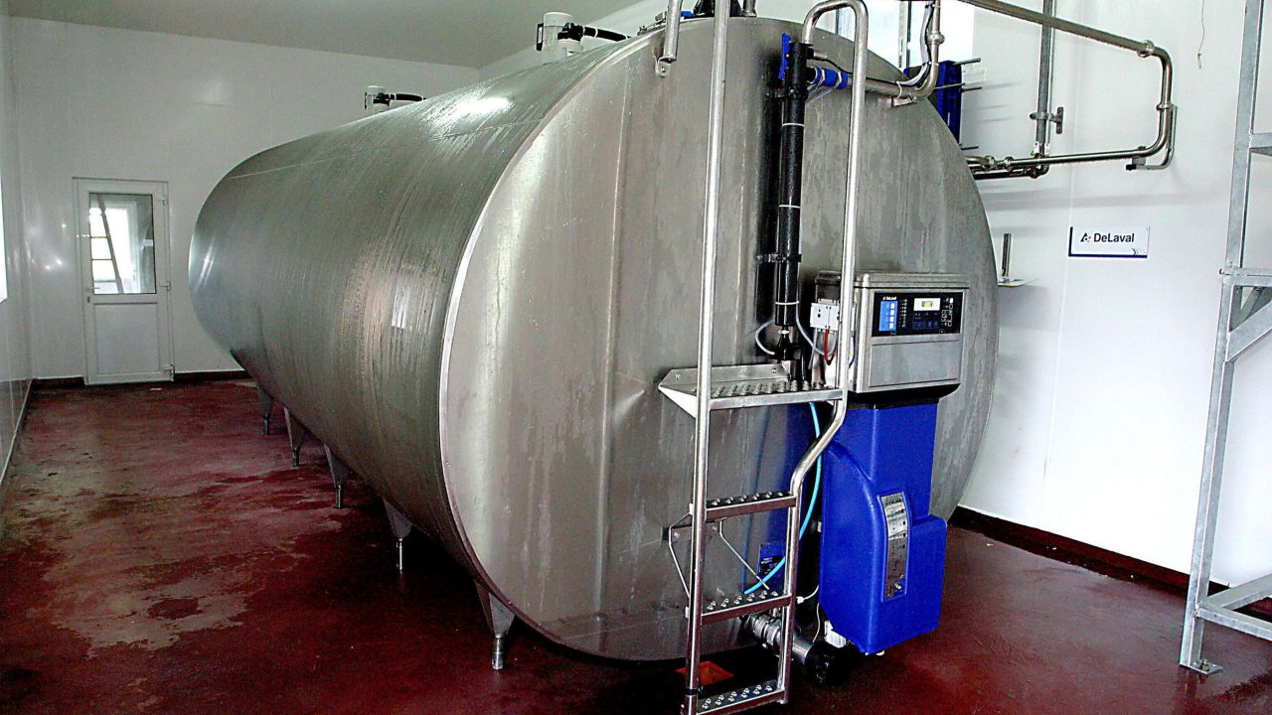
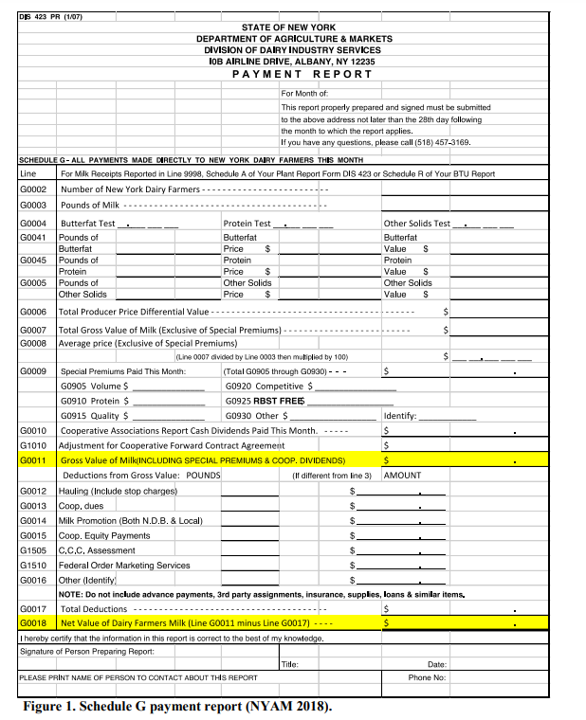
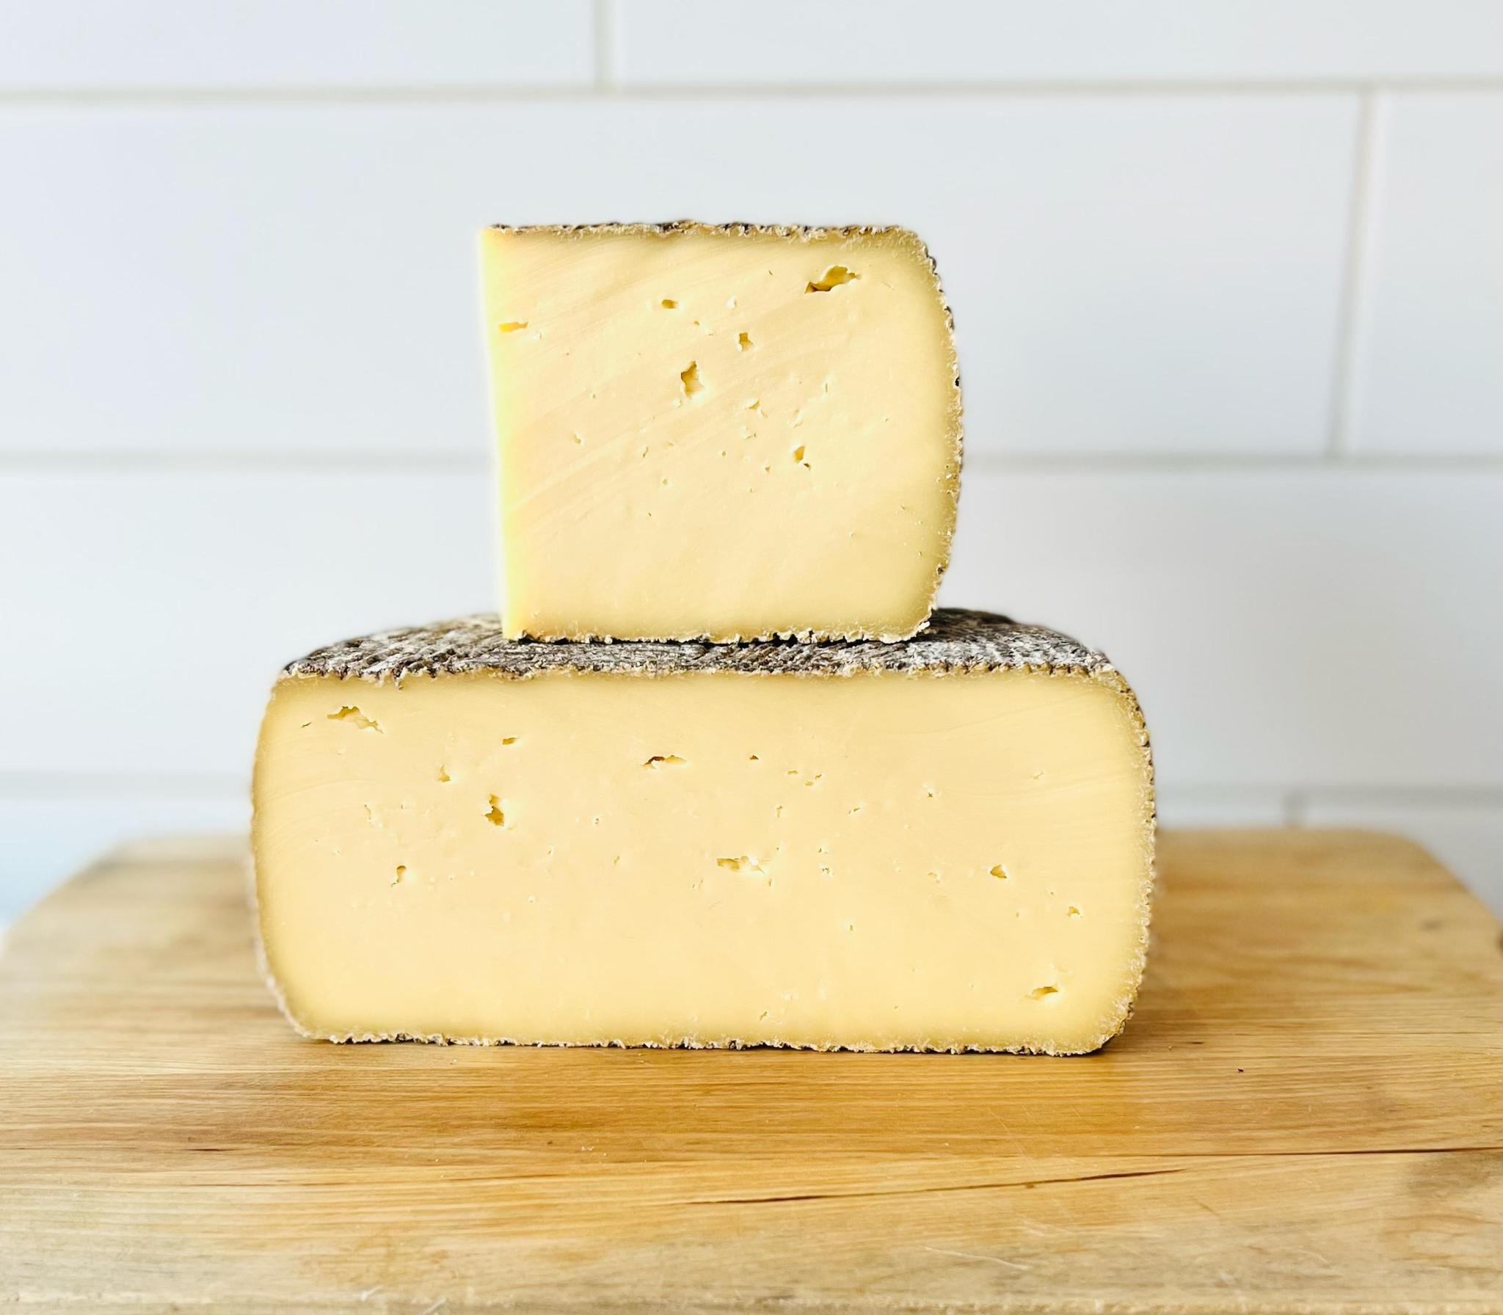
Non-aureus staphylococci and mammaliicocci (NASM) mastitis: Focus on S. chromogenes
Staphylococcus chromogenes most common when NAS speciated
S. chromogenes is of special concern
Most widespread
One of the most persistent
Most increase in SCC/clinical NAS mastitis
No effect on milk yield
When infections are widespread within a herd, this slight increase in SCC multiplied over the whole herd can have real effects on bulk tank somatic cell count, milk quality measurements and producer compensation
Notes:
with this diversity between species in mind, let’s focus in on the effect of the most commonly identified NAS species in particular: staphylococcus chromogenes.
S. chromogenes is of special concern
Most widespread
One of the most persistent (if not THE most persistent species, which one group recently found)
Supre 2011
Piessens 2011
Thorberg, 2009 (chromogenes in a group of NAS that can be persistent)
Fry 2014 (chromogenes in a group of NAS that can be persistent)
Mork 2012 (chromogenes in a group of NAS that can be persistent)
Nyman 2018 – species-specific differences in persistence capacity – chromogenes was third most persistent
Valckenier 2021
Most common one to cause clinical mastitis, most increase in SCC (even to a level comparable to that of staph. aureus or other “major” mastitis pathogens
Condas 2017 Chromogenes was the most frequent cause of CLINICAL NAS mastitis
Piessens 2011: caused 7.5% of clinical episodes of mastitis (7 total, 4 in mixed growth)
Tomazi 2015 – chromogenes increases quarter SCC
De Visscher 2016 – (one of three that elevates SCC)
Supré, 2011: one of a few species that are “more relevant for udder health;” because they can increase quarter SCC to a level comparable to that of S. aureus
Fry 2014: (one of few that elevates SCC)
Valckenier 2020: No difference between SCC in quarters infected with Staph. chromogenes and quarters infected with a major pathogen; No difference between quarters infected with any other NAS species than Staph. chromogenes and noninfected quarters
Wuytack 2020 (November JDS)
These milk samples had a higher LnqSCC than bacteriologically negative milk samples (P = 0.000 and P = 0.001, respectively) and samples harboring Corynebacterium spp. (P = 0.008 and P = 0.049, respectively), yet the LnqSCC was not different from the major pathogen–positive milk samples.
Wuytack 2020 (March Vet Research)
Chromogenes IS more of a concern; in one of their herds, “only samples from quarters with a SCC >50 000 cells/mL milk and clinical signs harbored S. chromogenes;” was the sole reason for increased SCC and clinical mastitis on this particular herd
One group has shown it to be a risk factor for developing IMI with S. aureus, although to my knowledge no one else has found support for this (Reyher 2012)
… and although we’re pretty sure chromogenes doesn’t affect milk yield, because of it’s widespread nature and ability to cause increased somatic cell counts… When infections are widespread within a herd, this slight increase in SCC multiplied over the whole herd can have real effects on bulk tank somatic cell count, which in turn affects milk quality measurements and ultimately producer compensation

Slide 29
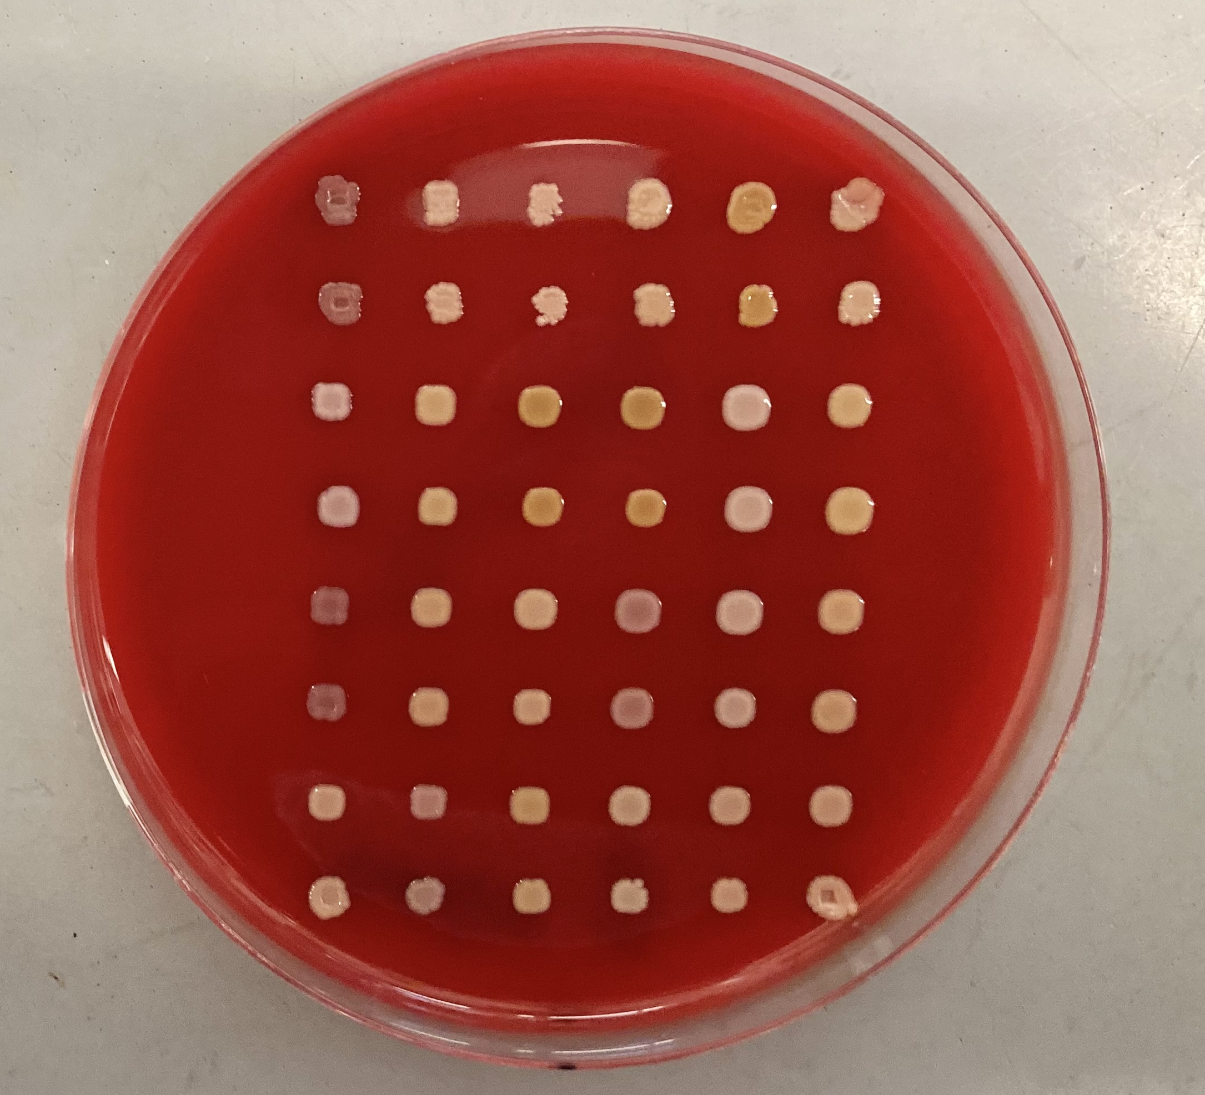
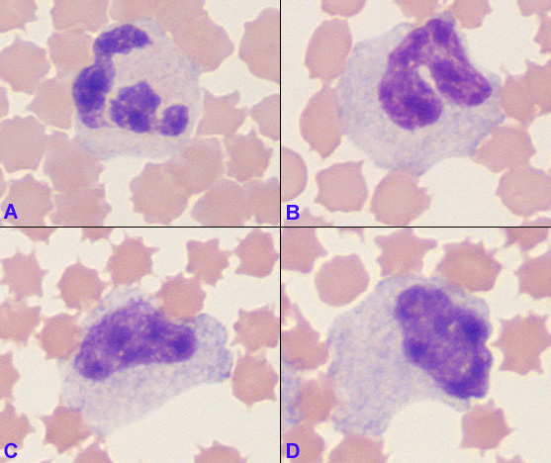
Non-aureus staphylococci and mammaliicocci (NASM) mastitis: Diversity within S. chromogenes
Generally, high levels of diversity among S. chromogenes from bovine IMI
Little difficult to compare between studies, variable ways of characterizing strain types
RAPD, PFGE, MLST…
Evidence for intra-species variation in S. chromogenes
Difference in persistence of S. chromogenes IMI
Half of the S. chromogenes intramammary infections associated with high SCC infection, half with low SCC
Variability of virulence/host immune response to different strains of S. chromogenes
Bacterial and somatic cell counts, as well as neutrophil responses, higher after inoculation with S. chromogenes from an intramammary infection than with S. chromogenes isolated from teat skin
S. chromogenes from an IMI showed a greater ability to adhere to and internalize into mammary epithelial cells than the S. chromogenes strain from teat skin
Differ in habitat niche
Some RAPD types found in milk, on skin, and feces; one only found in milk, and caused both clinical and subclinical mastitis
Certain indistinguishable strains of S. chromogenes across different cows within the same herd, others showed more genetic variability
Notes:
Generally, high levels of diversity among S. chromogenes from bovine IMI have been detected
Mostly heterogenous
Sheela 2021, Qu 2018, Gillespie 2009, Wuytack 2020
Difficult to generalize the results or compare the RAPD or PFGE types between distant geographical locations due to the small number of studies relating S. chromogenes, Also, variable ways of characterizing strain types
Little difficult to compare between studies, variable ways of characterizing strain types:
RAPD, PFGE, MLST
Besides the marked differences between different species in the group of bacteria known as non-aureus staphylococci, significant variation also exists within strains of the same species.
Difference in persistence of S. chromogenes IMI (Valckenier 2021, Mork 2012)
Half of the S. chromogenes intramammary infections associated with high SCC infection, half with low SCC (Condas 2017)
Variability of virulence/host immune response to different strains of S. chromogenes
Bacterial and somatic cell counts, as well as neutrophil responses, higher after inoculation with S. chromogenes from an intramammary infection than with S. chromogenes isolated from teat skin (Breyne 2015, mouse model; Piccart 2016, bovine)
S. chromogenes from an IMI showed a greater ability to adhere to and internalize into mammary epithelial cells than the S. chromogenes strain from teat skin (Souza 2016)
Differ in habitat niche
Some RAPD types found in milk, on skin, and feces; one only found in milk, and caused both clinical and subclinical mastitis (Wuytack 2020 Vet. Res.)
Certain indistinguishable strains of S. chromogenes across different cows within the same herd, others showed more genetic variability (Jenkins 2019)
Intraspecies variation in pathogenicity (ability to cause disease) has been demonstrated in varying effect on somatic cell count within a species [4, 14], difference in interaction with host immune cells [10, 11], persistence of infection [7, 19] and effect on milk production [8]. For S. chromogenes specifically, the link has been made between particular strain types and phenotypic differences in pathogenicity, such as interaction with host immune cells and inflammatory response [breyne/piccart/souza], and habitat niche [28, 29].

Slide 30
Non-aureus staphylococci and mammaliicocci (NASM) mastitis: Diversity within S. chromogenes
Specific S. chromogenes strain types exhibit differences in ability to cause disease
Intra-species diversity within S. chromogenes: linking phenotype to genotype?
Do these phenotypic/behavioral differences have a basis in genetic differences?
S. chromogenes associated with more severe mastitis more likely to have genes encoding various virulence factors than isolates associated with less severe mastitis (Wuytack 2019)
Notes:
so, what all this previous work suggests is that..
The next logical step in understanding this diversity within S. chromogenes is to see if we can link phenotype to genotype-
so far, i’ve come across one study that has started to make this link of a genotypic basis for behavioral differences- chromogenes isolates causing more severe mastitis were more likely to have genes encoding various virulence factors than those isolates associated with less severe cases of mastitis
associated with capsule formation, biofilm formation and evasion of host immune response, and various other enzymes associated with virulence proteins
The next logical step in understanding the diversity within S. chromogenes is to identify the genetic basis for difference in strain pathogenicity. Wuytack et. al found genes encoding various virulence factors associated with staphylococci in 44% of NAS isolates originating from cases of more severe mastitis, while only 19% of isolates associated with infections causing a less-severe inflammatory response. These virulence factors were genes associated with biofilm formation to enhance colonization and evasion of host immune response, enzymes associated with other virulence proteins, and capsule formation protecting the bacteria from being killed by host cells [20]. As S. chromogenes was the most common type of non-aureus staphylococci causing intramammary infections in our longitudinal study, I have a large population of isolates to choose from and an associated measure of host immune response (quarter somatic cell count) to further explore the genetic basis for differential virulence of the most common pathogen causing IMI in dairy cows, S. chromogenes.

Slide 31
Project objectives: Research Objective 3
Objective 3:
a) Identify if distinct strain types of S. chromogenes causing persistent intramammary infections will be associated with IMI where quarter SCC is consistently elevated (HIGH SCC phenotype), vs. intramammary infections where quarter SCC stays consistently low (LOW SCC phenotype)
Persistent = ≥30 days
HIGH SCC = quarter SCC ≥ 200,000 cells/mL for duration of observed infection
LOW SCC = quarter SCC <200,000 cells/mL for duration of observed infection
S. chromogenes most common species, persistent infections most common type of infection (n = 136)
n = 60 infections stay below 200,000 cells/mL, n = 15 above
Ensure infections truly persistent by strain-typing (RAPD, n = 198 isolates)
b) Identify if strain types of S. chromogenes from the HIGH SCC phenotype are more likely to carry genes encoding virulence factors as determined by whole-genome sequencing
From confirmed persistent infections, 15 isolates from HIGH SCC phenotype and 15 from LOW SCC phenotype selected for whole-genome sequencing
Compare differences in virulence factor gene profiles between two the phenotypic categories
Compare types and numbers of virulence factors among strains
Expected results:
Determine if certain S. chromogenes IMI strains are associated with persistent HIGH SCC or LOW SCC phenotypes, and if isolates associated with HIGH SCC intramammary infections possess more genes encoding virulence factors.
Notes:
Objective 3: a) Identify if distinct strain types of S. chromogenes causing persistent intramammary infections will be associated with IMI where quarter SCC is consistently elevated (HIGH SCC phenotype), vs. intramammary infections where quarter SCC stays consistently low (LOW SCC phenotype) and b) if strain types of S. chromogenes from the HIGH SCC phenotype are more likely to carry genes encoding virulence factors as determined by whole-genome sequencing. Objective 3 will focus on S. chromogenes, the most common species identified, and persistent infections (≥30 days), the most common type of NAS infection seen in our study.
I will compare isolates from two infection phenotypes of S. chromogenes intramammary infections: isolates associated with a HIGH SCC intramammary infection (qSCC ≥ 200,000 cells/mL for duration of observed infection), and isolates associated with a LOW SCC IMI (qSCC <200,000 cells/mL for duration of observed infection). 136 persistent intramammary infections were determined to be caused by s. chromogenes.
S. chromogenes was the most common species identified, and persistent infections (≥30 days) the most common type of infection seen (n = 136)
60 infections stay below 200,000, 15 above
In order to ensure that these intramammary infections are indeed persistent (and not a cured infection, followed by reinfection with the same species of bacteria), all S. chromogenes isolates from every sampling occurrence associated with each persistent infection will be strain-typed using RAPD-PCR as previously described following traditional DNA extraction … (RAPD, n = 198 isolates)
From among these confirmed persistent S. chromogenes intramammary infections, 15 isolates from the HIGH SCC phenotype group of IMI and 15 from the LOW SCC phenotype IMI will be selected for whole-genome sequencing.
Compare differences in virulence factor gene profiles between two phenotypic categories
Compare types and numbers of virulence factors among strains
Differences in virulence factor gene profiles will be mapped for isolates exploring potential differences among the two phenotypic categories, and logistic regression modeling will be used to determine associations between the phenotypic categories and the types and numbers of virulence factors among strains. Objective 3 will determine if certain S. chromogenes IMI strains are associated with persistent HIGH SCC or LOW SCC phenotypes, and if isolates associated with HIGH SCC intramammary infections possess more genes encoding virulence factors.

Slide 32
Specific objectives, Project 3:
Identify if distinct strain types (ST) of S. chromogenes are associated with IMI where qSCC is consistently elevated (HIGH SCC IMI) vs. consistently low (LOW SCC IMI)
Identify if S. chromogenes from HIGH SCC IMI are more likely to carry genes encoding for antimicrobial resistance (as determined by whole genome sequencing) vs. LOW SCC IMI
Identify if S. chromogenes from HIGH SCC IMI possess a larger number of genes encoding previously-described staphylococcal VF vs. LOW SCC IMI
Notes:
the specific objectives for this project are to:
identify the incidence, elimination, and prevalence of NASM IMI (generally, as a group) and for the most frequently-found NASM species, and
identify if infection risk is associated with various herd-, cow-, and quarter-level predictors for both NASM generally (as a group), and the most frequently-found NASM species through a model-building approach

Slide 33
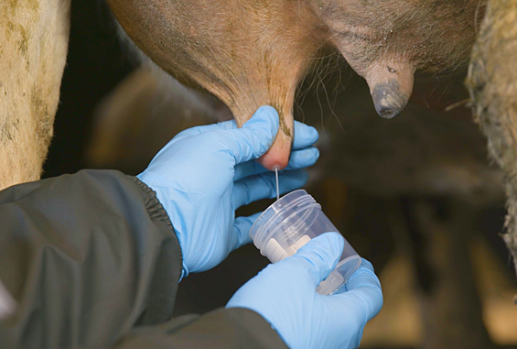
Methods: Selection of persistent IMI
Visit 1
Visit 2
Visit 3
S. chromogenes IMI
S. chromogenes IMI
S. chromogenes IMI
Select potentially persistent S. chromogenes IMI:
1) ≥ 2 quarter-day observations (sequential sampling events ~30 days apart)
2) IMI status can be determined for all associated sampling events
3) Infected with S. chromogenes only for all associated quarter-day observations
Milk sample collection photo: www.topfarmers.co.nz
Notes:
A given quarter was considered to have a potentially persistent S. chromogenes IMI if: 1) it had ≥ 2 quarter-day observations (from sequential sampling events approximately 30 days apart); 2) IMI status could be determined for all sampling events associated with that quarter; and 3) it was infected with S. chromogenes only for all associated quarter-day observations throughout the study.

Slide 34
Methods: Selection of persistent IMI
Visit 1
Visit 2
Visit 3
SCC ≥200,000 cells/mL
OR
SCC <200,000 cells/mL
SCC ≥200,000 cells/mL
OR
SCC <200,000 cells/mL
SCC ≥200,000 cells/mL
OR
SCC <200,000 cells/mL
Categorize persistent S. chromogenes IMI into SCC groups:
1) IMI associated with HIGH SCC, where all quarter-day observations had an associated SCC of ≥200,000 cells/mL
2) IMI associated with LOW SCC, where all quarter-day observations had an associated SCC of <200,000 cells/mL
Milk sample collection photo: www.topfarmers.co.nz
Notes:
Two groups were then selected from all potentially persistent S. chromogenes IMI:
IMI associated with high SCC, where all quarter-day observations had an associated SCC of ≥200,000 cells/mL; and
IMI associated with low SCC, where all quarter-day observations had an associated SCC of <200,000 cells/mL.
Any potentially persistent S. chromogenes IMI that did not fit into 1 of these 2 categories was excluded from further analysis (e.g., had an SCC of <200,000 cells/mL for one quarter-day observation and an SCC of ≥200,000 cells/mL for the next).

Slide 35
Methods: Confirming persistent IMI
Strain-typing to confirm persistent IMI
Confirm all isolates associated with each S. chromogenes IMI truly persistent
75 potentially persistent IMI, 198 associated isolates
Random amplification of polymorphic DNA (RAPD-PCR)
All isolates from a given persistent IMI analyzed in the same PCR, same gel
Same banding pattern, number, size of bands = same RAPD type
Same RAPD type = persistently infected with same strain
Cow A RH
Cow B LF
visit 1
visit 2
visit 3
visit 1
visit 2
visit 3
Notes:
All isolates associated with each potentially persistent high and low SCC S. chromogenes IMI were strain-typed using random amplification of polymorphic DNA (RAPD)-PCR.
markers are DNA fragments from PCR amplification of random segments of genomic DNA with single primer of arbitrary nucleotide sequence; PCR using a large template of genomic DNA, hoping that fragments will amplify. By resolving the resulting patterns, a semi-unique profile can be gleaned from an RAPD reaction.
There were 15 potentially persistent IMI where all quarter-day observations had an associated SCC of ≥200,000 cells/mL, 60 where all quarter-day observations had an associated SCC of <200,000 cells/mL, and 61 which had an associated SCC both above and below 200,000 cells/mL.
The RAPD-PCR product of all isolates from a given persistent IMI were analyzed in the same PCR amplification and were run side-by-side on the same gel. The images were inspected visually, and isolates with the same banding pattern, number, and size of bands were considered to be the same RAPD type. If the isolates from all quarter observations of an S. chromogenes IMI belonged to the same RAPD type, the quarter was considered persistently infected with the same strain.

Slide 36
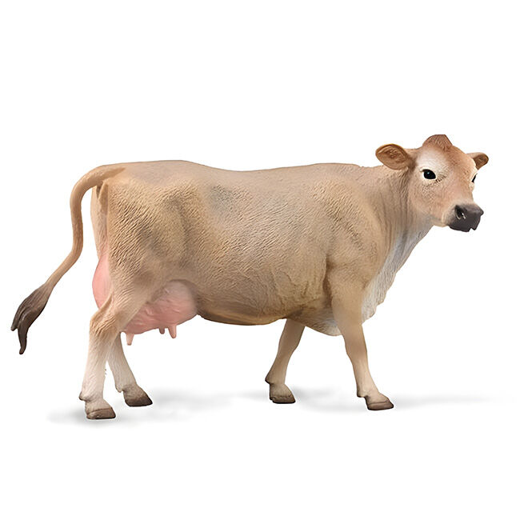

Methods: Isolate selection
Breyerhorses.com
Selection of HIGH and LOW SCC IMI
15 quarters with a persistently HIGH SCC IMI identified
15 quarters with a persistently LOW SCC IMI matched to HIGH SCC IMI
Matched on:
When possible:
Different quarter belonging to same cow
Same farm
Same facility type (TS vs. BP)
Days in milk
Parity
Selection of representative isolate for whole genome sequencing
Three quarter day observations = middle isolate in series
Two quarter day observations = haphazard selection of first or second
Bankrate.com
S. chromogenes IMI
S. chromogenes IMI
S. chromogenes IMI
Notes:
From among the confirmed persistent S. chromogenes IMI, 15 quarters with a persistently low SCC IMI (LOW SCC IMI) were selected to match the 15 quarters with a persistently high SCC IMI (HIGH SCC IMI). LOW SCC IMI quarters were matched to HIGH SCC IMI quarters belonging to the same cow (different quarter) when possible. If this was not possible, LOW and HIGH SCC IMI quarters were matched on farm, or facility type (bedded pack vs. tiestall) when same farm was not possible. When LOW and HIGH SCC IMI quarters were paired between different cows, quarters were matched as closely as possible to ensure a similar DIM and parity. From each of the 15 HIGH and 15 LOW SCC IMI, a representative isolate was chosen to undergo whole genome sequencing (WGS). For each persistent IMI which had 3 associated quarter-day observations, the middle isolate in the series was submitted for WGS. For persistent IMI which had 2 associated quarter-day observations, 1 of the 2 isolates in the series was haphazardly selected for WGS.

Slide 37
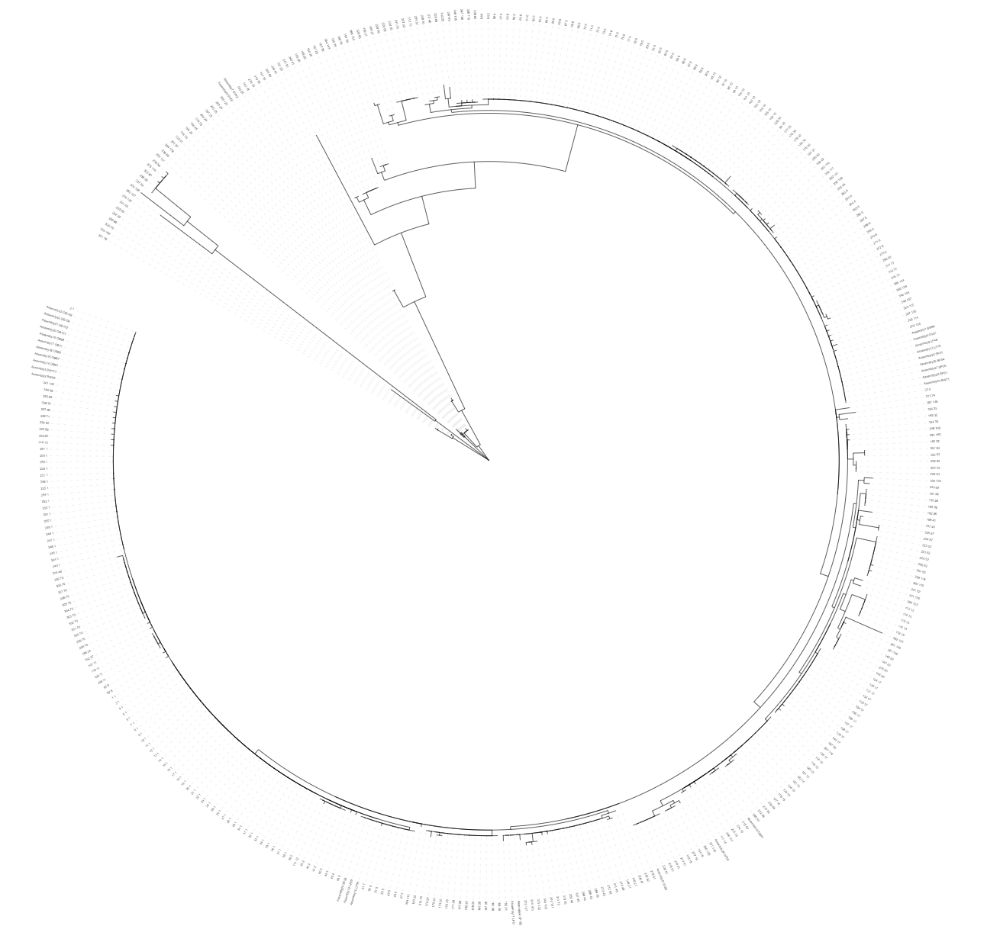
Methods: WGS and MLST
Whole genome sequencing
30 representative S. chromogenes isolates submitted for WGS
15 from persistently LOW SCC IMI and 15 from HIGH SCC IMI
DNA extraction from blood agar plates
Hybrid assembly of genomes
Long-read sequencing (Oxford Nanopore)
Paired-end sequencing (Illumina)
In silico multilocus sequence typing (MLST)
7-locus scheme for S. chromogenes (Huebner et al., 2021)
MLST 2.0, Center for Genomic Epidemiology, Technical University of Denmark
Novel alleles confirmed using Sanger sequencing
Identification of clusters
Notes:
M and M: chromogenes, DNA extraction, whole genome sequencing, assembly, and annotation
Each of the 30 representative S. chromogenes isolates selected for WGS were grown from frozen stock on blood agar, then to a commercial sequencing facility (SeqCoast Genomics) for DNA extraction, library preparation, long read sequencing using Oxford Nanopore, paired-end sequencing using Illumina, assembly, and annotation.
DNA extraction was performed on colony material collected from the agar plates with a commercial kit using bead beating
Unicycler v0.4.4 was used for hybrid assembly of all genomes
Multilocus sequence types (MLST) were predicted in silico from the annotated genomes for the 7-locus scheme described for S. chromogenes using the MLST 2.0 tool
Any novel alleles identified by were confirmed using PCR and Sanger sequencing.
The 7-locus concatenated nucleotide sequence data were then combined with all publicly available concatenated MLST sequences for S. chromogenes, and the resulting file was used to construct a phylogenetic tree by maximum-likelihood algorithm - Isolates which grouped together with a bootstrap value of ≥ 65% were classified as clusters.

Slide 38
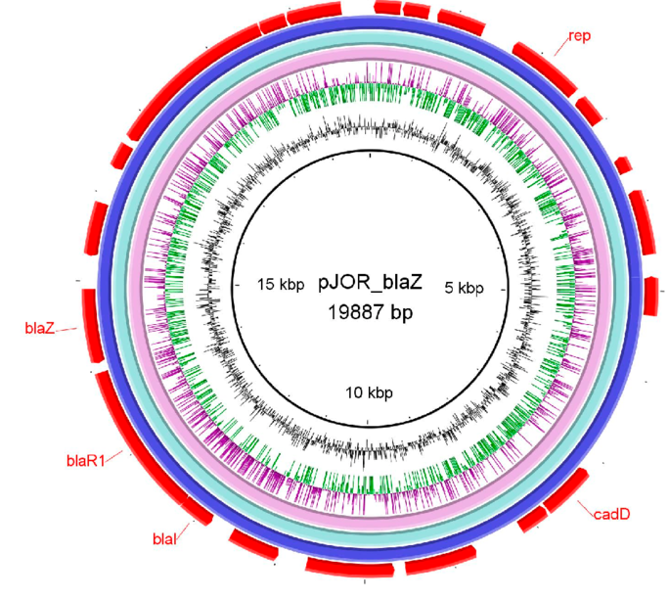
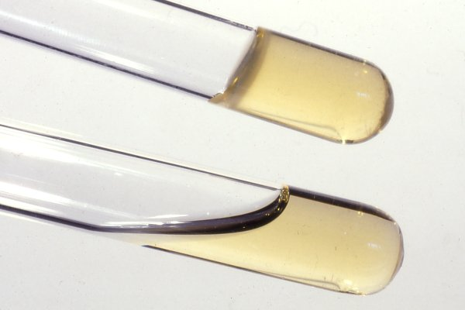
Methods: Identification of ARG and VF
Identification of antimicrobial resistance genes (ARG)
ARG identified from assembled genomes using ABRicate
ResFinder, CARD, MegaRES, AMRFinderPlus, ARG-ANNOT
Identification of virulence factors (VF)
VF identified using VFDB tool (Chen et al., 2016) and “blastp” search against published comprehensive dataset of staphylococcal VF (Naushad et al., 2019)
Best hit chosen based on H value (Fukiya et al., 2004)
Similarity between query protein sequence from database and assembled genomes
30% cut-off for sequence similarity, 50% cut-off for query length coverage
Select hit with highest H value
Categorization of VF factors
Five functional categories (Naushad et al., 2019)
Adherence, exoenzymes, host immune evasion, iron uptake and metabolism, toxins
Gaber et al., 2024
Vetbact.org
Notes:
ARG were identified from assembled genomes using ABRicate v1.01, which draws from 5 different databases
VF were identified from assembled genomes using the VFDB tool and a “blastp” search against a published comprehensive dataset of staphylococcal VF
After the blast search, the best hit of virulence genes for each genome was chosen based on H values, which is essentially a score of how well the query protein sequence from database and assembled genomes from this project
A cutoff was established for sequence similarity of 30% and a query length coverage of 50%, with any hits having values below these cutoffs discarded from the data set. Hits from each query sequence were then arranged according to their H value, and the hit with the largest H value (highest sequence similarity and query length coverage) was selected in order to prevent 1 VF query returning hits to 2 different genes within a given genome.
The list of remaining VF were classified into 5 functional categories, as outlined in Naushad et al. (2019): 1) adherence, 2) exoenzymes, 3) host immune evasion, 4) iron uptake and metabolism, and 5) toxins (including hemolysins, leukocidins, leukotoxins, toxic shock syndrome toxin, exfoliative toxins, type VII secretion system genes, phenol-soluble modulins, enterotoxins, and exotoxins).
Briefly, an H value was calculated to determine homology between query protein sequences and blast hits (Fukiya et al., 2004). H values (in units of amino acids) between protein sequences were calculated using the following formula: H = VFid × Lm/Lq, where VFid represents the percent similarity between the VF query sequence and the identified protein sequence (expressed as proportion between 0 and 1), Lm represents the alignment length, and Lq denotes the length of the query sequence (Fukiya et al., 2004).

Slide 39
Methods: Statistical analyses
Descriptive statistics
Describe parity, DIM, quarter location, avg. SCC for LOW SCC and HIGH SCC groups
Mann Whitney U test, Fisher’s Exact test used to compare metrics
Mixed-effects logistic regression models
Separate models where predictor was:
Strain type (ST)
ST cluster
ARG carriage
Number of VF identified
All models:
Outcome variable = SCS of a quarter on a given day; quarter-day IMI status = main predictor
Random intercept for herd
Notes:
Descriptive statistics were generated to compare parity and DIM of the cow, quarter location, and average SCC associated with each persistent IMI between the two SCC categories (HIGH vs. LOW).
After checking distribution of the data, used a Mann Whitney U test or Fisher’s Exact test as appropriate to compare metrics the two groups.
Separate mixed-effects logistic regression models were made using ST (as determined by MLST), ST cluster, blaZ carriage, and VF number as the predictor, SCC category as the outcome, and herd as a random effect using the “lme4” package (R Development Core Team, 2023).

Slide 40
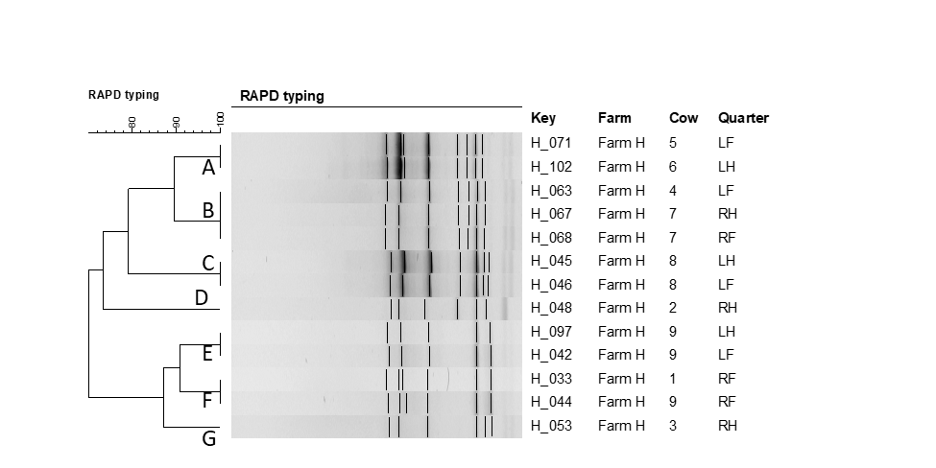
Notes:
Figure 1. Example of dendrogram of the RAPD fingerprints of 13 Staphylococcus chromogenes isolates representative of an IMI associated with a persistently high (≥200,000 cells/mL) or low (<200,000 cells/mL) SCC, originating from Farm H. RAPD types were assigned an arbitrary lower case letter based on the clustering. Seven RAPD types were identified from the 13 isolates causing IMI.

Slide 41
Table 1. Diversity of RAPD types causing persistently high and low SCC Staphylococcus chromogenes intramammary infections by farm. An S. chromogenes IMI was considered persistent if it had ≥ 2 quarter-day observations (from sequential sampling events approximately 30 days apart) and it was infected with S. chromogenes only for all quarter-day observations. Persistent IMI were then selected where all quarter-day observations had an associated SCC of ≥200,000 cells/mL or <200,000 cells/mL. All isolates associated with each IMI were strain-typed using RAPD to ensure persistency; 74 out of 75 IMI were found to be caused by the same strain of S. chromogenes.
Farm | No. persistent IMI | No. RAPD types
Farm A | 8 | 3
Farm C | 14 | 9
Farm D | 6 | 3
Farm E | 7 | 5
Farm F | 3 | 2
Farm G | 8 | 5
Farm H | 13 | 7
Farm I | 3 | 2
Farm J | 11 | 6

Slide 42
Table 2. Number of Staphylococcus chromogenes isolates associated with persistent bovine intramammary infections belonging to each strain type (ST; as determined by multilocus sequence typing), stratified by SCC category. All isolates in the HIGH category come from IMI which had an SCC of ≥200,000 cells/mL associated with all quarter-day observations, and all isolates in the LOW category come from IMI which had an SCC of <200,000 cells/mL associated with all quarter-day observations. A phylogenetic tree was constructed from concatenated nucleotide sequence data for the study isolates as well as 386 publicly-available concatenated MLST sequences for S. chromogenes. Study isolates which grouped together with a bootstrap value of ≥65% were classified as ST clusters.
SCC category | Strain type | ST cluster | No. isolates
HIGH | 5 | 5 | 1
 | 6 | 6 | 5
 | 25 | 25 | 2
 | 48 | 48 | 1
 | 136 | - | 1
 | 176* | 1 | 4
 | 177* | - | 1
LOW | 5 | 5 | 2
 | 6 | 6 | 4
 | 48 | 48 | 1
 | 51 | - | 1
 | 174* | 1 | 1
 | 175* | 1 | 1
 | 176* | 1 | 5
* Indicates a novel strain type of S. chromogenes not previously identified in PubMLST

Slide 43
Table 3. blaZ gene carriage by strain type (as determined by multilocus sequence typing) and ST cluster for 30 Staphylococcus chromogenes isolates associated with persistent bovine intramammary infections.
Strain type | ST cluster | Prop. isolates + for blaZ (%)
6 | 6 | 4/9 (44%)
176 | 1 | 0/9 (0%)
5 | 5 | 3/3 (100%)
25 | 25 | 0/2 (0%)
48 | 48 | 2/2 (100%)
51 | - | 1/1 (100%)
136 | - | 0/1 (0%)
174 | 1 | 0/1 (0%)
175 | 1 | 0/1 (0%)
177 | - | 0/1 (0%)

Slide 44
Table 4. Presence of potential virulence factors and related genes for 30 Staphylococcus chromogenes isolates from subclinical bovine intramammary infections, stratified by SCC category. All isolates in the HIGH category (n = 15) come from IMI which had an SCC of ≥200,000 cells/mL associated with all quarter-day observations, and all isolates in the LOW (n = 15) category come from IMI which had an SCC of <200,000 cells/mL associated with all quarter-day observations. Grouping scheme adapted from Naushad et al., 2019. Bolded virulence factors with an asterisk represent related genes that were unique to an SCC category.
Type of virulence |  |  | SCC category
Adherence | Virulence factor | Related genes | LOW n (%) | HIGH n (%)
 | Autolysin | atl | 15 (100) | 15 (100)
 | Biofilm-associated surface protein | bap | 14 (93.3) | 13 (86.7)
 | Fibronectin binding proteins | fnbA | 15 (100) | 13 (86.7)
 | Fibronectin binding proteins | fnbB | 15 (100) | 13 (86.7)
 | Ser-Asp-rich fibrinogen binding proteins | sdrC | 1 (6.7) | 1 (6.7)
 | Ser-Asp-rich fibrinogen binding proteins* | sdrD | 1 (6.7) | 0 (0)
 | Ser-Asp-rich fibrinogen binding proteins | sdrE | 1 (6.7) | 1 (6.7)
 | Ser-Asp-rich fibrinogen binding proteins | sdrG | 1 (6.7) | 1 (6.7)
Host immune evasion
 | Capsule formation* | capH | 0 (0) | 2 (13.3)
 | Capsule formation* | capJ | 0 (0) | 2 (13.3)
 | Capsule formation | capN | 15 (100) | 13 (86.7)
 | Capsule formation | capO | 15 (100) | 15 (100)
 | Capsule formation | capP | 15 (100) | 15 (100)
 | Staphylococcal complement inhibitor | scn | 15 (100) | 15 (100)
Iron uptake and metabolism
 | ABC transporter (siderophore receptor) | htsA | 15 (100) | 15 (100)
 | ABC transporter (siderophore receptor) | htsB | 15 (100) | 15 (100)
 | ABC transporter (siderophore receptor) | htsC | 15 (100) | 15 (100)
 | Iron-regulated surface determinant protein | isdF | 15 (100) | 15 (100)
 | Iron-regulated surface determinant protein | isdG | 15 (100) | 15 (100)
 | Iron-regulated surface determinant protein | isdI | 15 (100) | 15 (100)
 | Staphyloferrin B synthesis-related genes | sbnA | 15 (100) | 15 (100)
 | ABC transporter (siderophore receptor) | sfaA | 15 (100) | 15 (100)
 | ABC transporter (siderophore receptor) | sfaB | 15 (100) | 15 (100)
 | ABC transporter (siderophore receptor) | sfaC | 15 (100) | 15 (100)
 | ABC transporter (siderophore receptor) | sfaD | 15 (100) | 15 (100)
 | Staphyloferrin A synthesis-related | sirA | 15 (100) | 15 (100)
 | Staphyloferrin A synthesis-related | sirB | 15 (100) | 15 (100)
 | Staphyloferrin A synthesis-related | sirC | 15 (100) | 15 (100)
Exoenzymes
 | Adenosine synthase A | adsA | 15 (100) | 15 (100)
 | Aureolysin | aur | 15 (100) | 15 (100)
 | Staphylocoagulase* | coa | 0 (0) | 2 (13.3)
 | Lipase | geh | 15 (100) | 15 (100)
 | Lipase | lip | 15 (100) | 15 (100)
 | Thermonuclease | nuc | 15 (100) | 15 (100)
 | von Willebrand factor-binding protein | vWbp | 15 (100) | 15 (100)
Exotoxins
 | Staphylococcal exotoxin 10* | set10 | 0 (0) | 2 (13.3)
 | Staphylococcal exotoxin 15 | set15 | 15 (100) | 15 (100)
 | Staphylococcal exotoxin 16 | set16 | 15 (100) | 15 (100)
 | Staphylococcal exotoxin 18 | set18 | 1 (6.7) | 2 (13.3)
 | Staphylococcal exotoxin 20 | set20 | 13 (86.7) | 10 (66.7)
 | Staphylococcal exotoxin 21 | set21 | 1 (6.7) | 1 (6.7)
 | Staphylococcal exotoxin 26 | set26 | 15 (100) | 15 (100)
 | Staphylococcal exotoxin 3 | set3 | 15 (100) | 15 (100)
 | Staphylococcal exotoxin 30 | set30 | 15 (100) | 15 (100)
 | Staphylococcal exotoxin 34* | set34 | 0 (0) | 2 (13.3)
 | Staphylococcal exotoxin 40 | set40 | 15 (100) | 15 (100)
 | Staphylococcal exotoxin 6 | set6 | 15 (100) | 15 (100)
 | Staphylococcal exotoxin 8 | set8 | 1 (6.7) | 2 (13.3)
Toxins: Phenol soluble modulins
 | Phenol soluble modulins (β) | PSMB1 | 15 (100) | 15 (100)
 | Phenol soluble modulins (β) | PSMB2 | 15 (100) | 15 (100)
 | Phenol soluble modulins (β) | PSMB3 | 15 (100) | 15 (100)
 | Phenol soluble modulins (β) | PSMB4 | 15 (100) | 15 (100)
 | Phenol soluble modulins (β) | PSMB5 | 15 (100) | 15 (100)
 | Phenol soluble modulins (β) | PSMB6 | 15 (100) | 15 (100)
Toxins: Hemolysins
 | β-hemolysin | hlb | 15 (100) | 15 (100)
Toxins: Exfoliative toxins
 | Exfoliative toxin type c | etc | 15 (100) | 15 (100)
Toxins: Secretion system
 | Type VII secretion system | esaA | 1 (6.7) | 2 (13.3)
 | Type VII secretion system | esaB | 1 (6.7) | 2 (13.3)
 | Type VII secretion system | essA | 1 (6.7) | 2 (13.3)
 | Type VII secretion system | essB | 1 (6.7) | 2 (13.3)
 | Type VII secretion system | essC | 1 (6.7) | 2 (13.3)
 | Type VII secretion system | esxA | 1 (6.7) | 2 (13.3)

Slide 45
Carriage of blaZ by SCC category
blaZ -
blaZ +
High
n = 9
n = 6
SCC category
Low
n = 11
n = 4
Notes:
Figure 2. Carriage of the blaZ gene (encoding for the production of β-lactamase) for 30 Staphylococcus chromogenes isolates from subclinical bovine intramammary infections by SCC category. All isolates in the HIGH category (n = 15) come from IMI which had an SCC of ≥200,000 cells/mL associated with all quarter-day observations, and all isolates in the LOW (n = 15) category come from IMI which had an SCC of <200,000 cells/mL associated with all quarter-day observations.

Slide 46
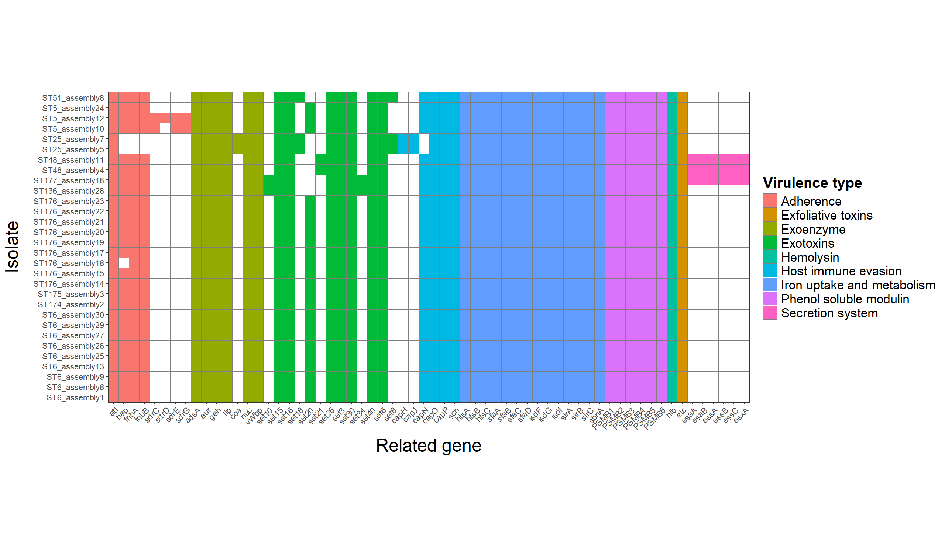
Notes:
Figure 3. Distributions of putative virulence genes for 30 Staphylococcus chromogenes isolates from subclinical bovine intramammary infections by virulence type. Isolates of the same strain type (ST; determined by multilocus sequence typing) are listed sequentially. Scheme for grouping putative virulence genes by type adapted from Naushad et al., 2019
Assembly 12 and 10- little different from assembly 24; 12 and 10 from one farm, 24 from a different farm

Slide 47
Notes:
Figure 3. Distributions of putative virulence genes for 30 Staphylococcus chromogenes isolates from subclinical bovine intramammary infections by virulence type. Isolates of the same strain type (ST; determined by multilocus sequence typing) are listed sequentially. Scheme for grouping putative virulence genes by type adapted from Naushad et al., 2019
Assembly 12 and 10- little different from assembly 24; 12 and 10 from one farm, 24 from a different farm

Slide 48
Table 6.1 Agreement between blaZ gene carriage and phenotypic susceptibility (using agar dilution) to penicillin by strain type (ST; as determined by MLST) for 30 Staphylococcus chromogenes isolates associated with persistent bovine intramammary infections. Isolates were defined as susceptible to penicillin if their MIC was 0.12 µg/mL or lower, and resistant if their MIC was 0.25 µg/mL (2018 Clinical & Laboratory Standards Institute guidelines). N = no blaZ carriage; Y = positive for blaZ carriage; S = susceptible to penicillin; R = resistant to penicillin.
Isolate | ST | ST cluster | blaZ carriage | Susceptibility phenotype (penicillin)
assembly_3 | 175 | 1 | N | S
assembly_2 | 174 | 1 | N | S
assembly_20 | 176 | 1 | N | -
assembly_21 | 176 | 1 | N | -
assembly_22 | 176 | 1 | N | -
assembly_23 | 176 | 1 | N | -
assembly_14 | 176 | 1 | N | -
assembly_15 | 176 | 1 | N | -
assembly_16 | 176 | 1 | N | -
assembly_17 | 176 | 1 | N | -
assembly_19 | 176 | 1 | N | -
assembly_10 | 5 | 5 | Y | -
assembly_24 | 5 | 5 | Y | -
assembly_12 | 5 | 5 | Y | R
assembly_1 | 6 | 6 | N | S
assembly_6 | 6 | 6 | N | S
assembly_9 | 6 | 6 | N | S
assembly_13 | 6 | 6 | N | S
assembly_30 | 6 | 6 | N | -
assembly_25 | 6 | 6 | Y | -
assembly_26 | 6 | 6 | Y | -
assembly_27 | 6 | 6 | Y | -
assembly_29 | 6 | 6 | Y | -
assembly_5 | 25 | 25 | N | S
assembly_7 | 25 | 25 | N | S
assembly_4 | 48 | 48 | Y | R
assembly_11 | 48 | 48 | Y | R
assembly_8 | 51 | 51 | Y | R
assembly_28 | 136 | 136 | N | -
assembly_18 | 177 | 177 | N | -
Notes:
Table 6.1 Agreement between blaZ gene carriage and phenotypic susceptibility (using agar dilution) to penicillin by strain type (ST; as determined by MLST) for 27 Staphylococcus chromogenes isolates associated with persistent bovine intramammary infections. Isolates were defined as susceptible to penicillin if their MIC was 0.12 µg/mL or lower, and resistant if their MIC was 0.25 µg/mL (2018 Clinical & Laboratory Standards Institute guidelines). N = no blaZ carriage; Y = positive for blaZ carriage; S = susceptible to penicillin; R = resistant to penicillin.

Slide 49
Conclusions (general importance of):
from my work

Slide 50
Conclusions: future directions

Slide 51
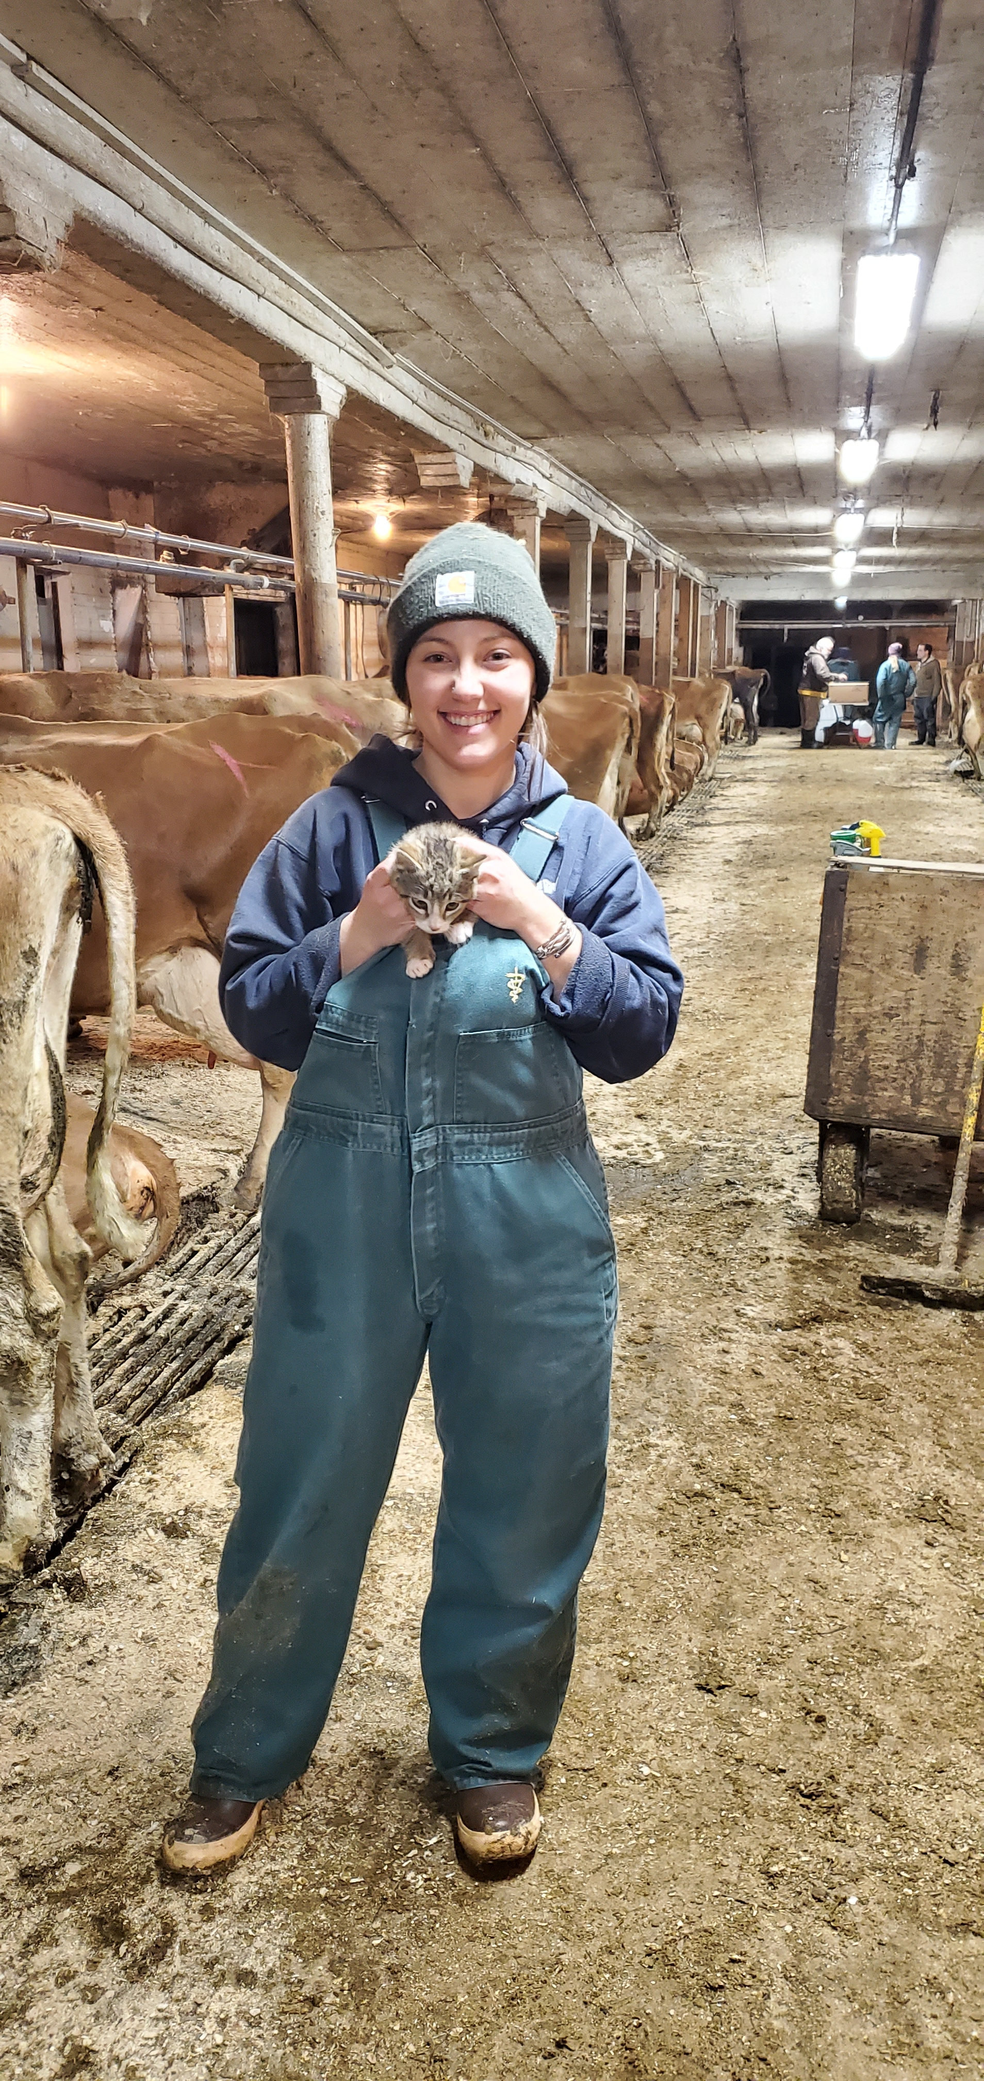
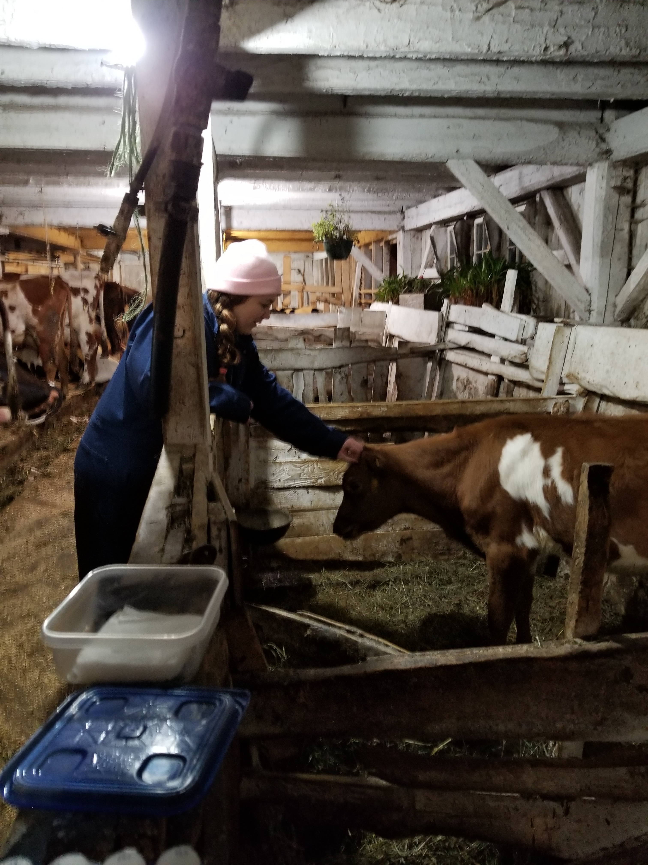
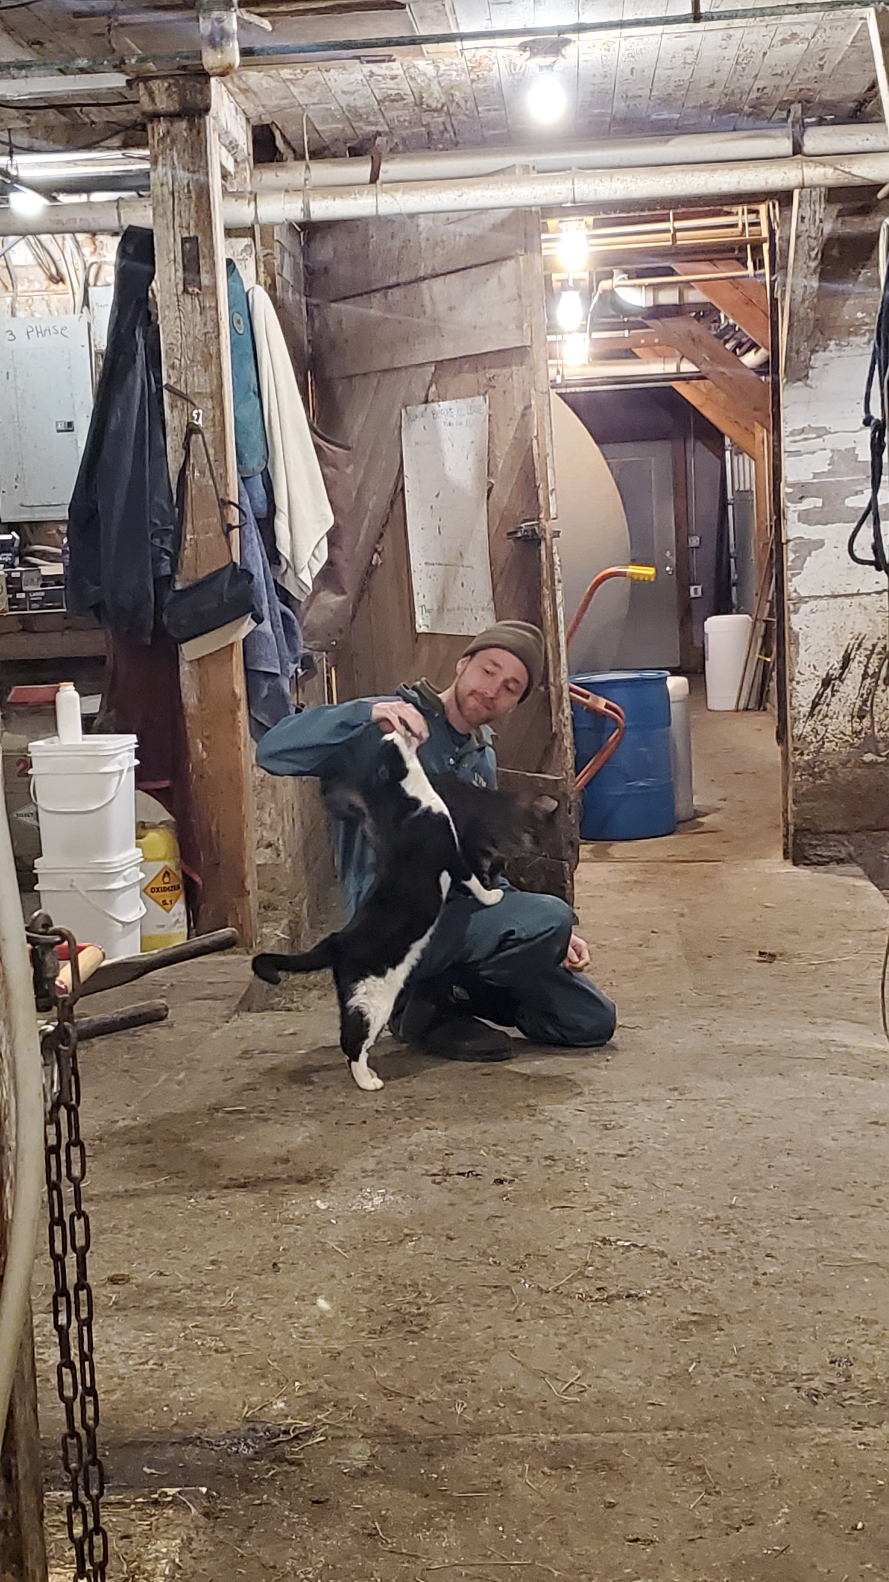

Acknowledgements:
Dr. John Barlow, Dept. of Animal and Veterinary Sciences, University of Vermont
Dr. Sandra Godden, Dept. of Veterinary Population Medicine, University of Minnesota College of Veterinary Medicine
Dr. Deborah Neher, Dept. of Agriculture, Landscape, and Environment, University of Vermont
Dr. Julia Smith, Dept. of Animal and Veterinary Sciences, University of Vermont
Dr. Jessica Crothers, Dept. of Pathology and Laboratory Medicine, University of Vermont
Dr. Pamela Adkins, Dept. of Veterinary Medicine and Surgery, University of Missouri
Dr. Simon Dufour, Faculty of veterinary medicine, Université de Montréal
Dr. Ashma Chakrawarti, Dept. of Surgery, University of Minnesota Medical School
Field study research team
Members of the Barlow Lab
Participating organic dairy producers
Vermont Agriculture and Environmental Laboratory, Randolph Center, VT
St. Albans Cooperative/Dairy Farmers of America, St. Albans, VT
Jennifer Timmerman and the Laboratory for Udder Health, Veterinary Diagnostic Lab, University of Minnesota
SeqCoast Genomics, Portsmouth, NH
Funding:
USDA Organic Agriculture Research and Extension Initiative (USDA-NIFA grant 2018-51300-28561)
USDA-NIFA Predoctoral Fellowship grant (USDA-NIFA grant 2022-67011-36567)
Notes:
… and with that, I’d like to acknowledge everyone who’s contributed to the work included in this dissertation:
Of course, my advisor…
Members of my committee, dr. godden, dr. neher, who served as committee chair, dr. smith and dr. crothers;
An additional thank you to dr. godden and dr. neher who are co-authors on a publication included in this dissertation
I wanted to take a moment to acknowledge collaborators from other institutions who have contributed to the work I talked about today:
Dr. pamela Adkins at Missouri, who did all the bacterial species identification by MALDI-TOF
Dr. Simon Dufour who has been collaborating with us on data analysis
And Dr. ashma chakrawarti, a recent PhD graduate from the Barlow lab, who contributed to the bioinformatic work in the last project I spoke about
Our amazing research team of UVM undergraduate students and recent grads
Members of the Barlow Lab over the years
and participating producers; for giving us their time and allowing us to collect samples from their farms; and who mostly kept their grumbling to themselves when we slowed down milking chores during herd samplings; we truly could not have completed any of this work without them, and I very much appreciate them welcoming a bunch of students onto their farms during their busiest time of day
funding for the field trial came from a USDA OREI grant, and my current funding comes from a USDA-NIFA predoctoral fellowship
Thank you everyone for your time and attention, and I’d love to welcome any questions or comments

Slide 52
Extra slides

Slide 53
Table 1. Quarter-level prevalence of pathogens (or grouping of similar pathogens) causing intramammary infections [median (range)] by farm, stratified by facility type. 3,332 quarter-level observations were collected from 1,456 quarters belonging to 382 cows during a longitudinal, cross-sectional observational study of 10 certified organic dairy farms in Vermont (US). The quarter-level prevalence represents the percent of sampled quarters infected with a particular pathogen over all sampled quarters at risk where IMI status could be determined for that farm visit. Median and range of quarter-level prevalence for each herd were calculated using all consecutive visits to a particular farm. Median and range of quarter-level prevalence for tiestalls (TS) and bedded packs (BP) were calculated over all visits to TS (n = 15) and BP (n = 15), respectively. Overall median and range of quarter-level prevalence were calculated using all visits to all 10 farms (n = 30).
 |  |  | TS-1 | TS-2 | TS-3 | TS-4 | TS-5 | TS avg. | BP-1 | BP-2 | BP-3 | BP-4 | BP-5 | BP avg. | Overall
Num. farm visits |  |  | 3 | 3 | 3 | 3 | 3 | 15 | 3 | 4 | 3 | 2 | 3 | 15 | 30
Pathogen (group)
 | Staphylococcus aureus |  | 3.5 (3.1-4) | 1.9 (1.7-2.4) | 4 (3.4-4.1) | 3.5 (3.2-3.9) | 0.9 (0.9-1) | 3.2 (0.9-4.1) | 4.8 (4.7-8.4) | 13.1 (11.7-14.1) | 0.8 (0-2.6) | 1.3 (0.9-1.7) | 0.8 (0-0.8) | 2.6 (0-14.1) | 3.2 (0-14.1)
 | Non-aureus staphylococci and mammaliicocci |  | 10 (9.7-10.4) | 19.6 (16.7-23.2) | 24 (22.3-25.6) | 15.8 (14.2-18.5) | 20.4 (19-24.5) | 19 (9.7-25.6) | 24.8 (21.9-39.8) | 14.1 (12.8-18.2) | 23.6 (21.9-25.5) | 19.4 (17.6-21.1) | 20.6 (19.4-22.4) | 21.1 (12.8-39.8) | 20 (9.7-39.8)
 |  | Staphylococcus agnetis | 2 (1.8-2.1) | 0 (0-0) | 0 (0-0.8) | 0 (0-0) | 0 (0-0.9) | 0 (0-2.1) | 2.4 (0.8-3.6) | 1.1 (0-2) | 0 (0-0) | 0.9 (0.8-0.9) | 0.8 (0.8-0.9) | 0.8 (0-3.6) | 0.8 (0-3.6)
 |  | Staphylococcus auricularis | 0 (0-0) | 0 (0-0) | 0 (0-0) | 0 (0-0.8) | 0 (0-0) | 0 (0-0.8) | 0 (0-0) | 0 (0-0) | 0 (0-0) | 0 (0-0) | 0 (0-0) | 0 (0-0) | 0 (0-0.8)
 |  | Staphylococcus capitis | 0 (0-0) | 0 (0-0) | 0 (0-0) | 0.8 (0-0.8) | 0 (0-0) | 0 (0-0.8) | 0 (0-0) | 0 (0-0) | 0 (0-0) | 0 (0-0) | 0 (0-0) | 0 (0-0) | 0 (0-0.8)
 |  | Staphylococcus chromogenes | 6 (5.3-6.3) | 13.1 (11.7-15.9) | 16.2 (14.9-16.8) | 8.8 (7.1-8.9) | 15.5 (13.8-15.5) | 13.1 (5.3-16.8) | 15.2 (13.3-21.7) | 7.8 (6.5-10.1) | 19.5 (17.5-21.8) | 15.9 (14.3-17.4) | 16.8 (16.1-17.6) | 16.1 (6.5-21.8) | 14.6 (5.3-21.8)
 |  | Staphylococcus cohnii | 0 (0-0) | 0.9 (0.8-1.2) | 0 (0-0) | 0 (0-0) | 0 (0-0) | 0 (0-1.2) | 0 (0-0) | 0 (0-0) | 0 (0-0) | 0 (0-0) | 0 (0-0) | 0 (0-0) | 0 (0-1.2)
 |  | Staphylococcus devriesei | 0 (0-0) | 0.9 (0.8-1.2) | 0 (0-0) | 0 (0-0) | 1.9 (1.7-2.7) | 0 (0-2.7) | 0.8 (0.8-2.4) | 1 (0-1.1) | 0 (0-0) | 0 (0-0) | 0 (0-0) | 0 (0-2.4) | 0 (0-2.7)
 |  | Staphylococcus epidermidis | 0 (0-0) | 0 (0-0) | 0 (0-0) | 0 (0-0) | 0 (0-0) | 0 (0-0) | 0 (0-0) | 0 (0-1) | 0 (0-0) | 0 (0-0) | 0 (0-0) | 0 (0-1) | 0 (0-1)
 |  | Staphylococcus equorum | 0 (0-0) | 3.7 (1.7-3.7) | 0 (0-0) | 0 (0-0) | 1 (0.9-1.7) | 0 (0-3.7) | 0 (0-1.2) | 0 (0-1.1) | 0 (0-0) | 0 (0-0) | 0 (0-0) | 0 (0-1.2) | 0 (0-3.7)
 |  | Staphylococcus gallinarum | 0 (0-0) | 0 (0-0) | 0 (0-0) | 0 (0-0) | 0 (0-0) | 0 (0-0) | 0.8 (0-1.2) | 0 (0-0) | 0 (0-0) | 0 (0-0) | 0 (0-0) | 0 (0-1.2) | 0 (0-1.2)
 |  | Staphylococcus haemolyticus | 1 (0.9-1) | 0 (0-0) | 0.8 (0.8-1.7) | 1.6 (1.6-1.8) | 0 (0-0.9) | 0.9 (0-1.8) | 3.1 (2.4-4.8) | 3 (2.1-3.3) | 3.3 (2.7-3.5) | 0.9 (0.8-0.9) | 0.8 (0-1.9) | 2.7 (0-4.8) | 1.3 (0-4.8)
 |  | Staphylococcus hominis | 0 (0-0) | 0 (0-0) | 0 (0-0) | 0 (0-0.8) | 0 (0-0) | 0 (0-0.8) | 0 (0-0) | 0 (0-0) | 0 (0-0) | 0 (0-0) | 0 (0-0) | 0 (0-0) | 0 (0-0.8)
 |  | Staphylococcus hyicus | 0 (0-0) | 0 (0-0) | 0.8 (0.8-0.9) | 0 (0-0) | 0 (0-0) | 0 (0-0.9) | 0 (0-0) | 1 (0-1.1) | 0 (0-0) | 0 (0-0) | 0 (0-0) | 0 (0-1.1) | 0 (0-1.1)
 |  | Staphylococcus pseudintermedius | 0 (0-0) | 0.9 (0.8-1.2) | 0 (0-0) | 0 (0-0) | 0 (0-0) | 0 (0-1.2) | 0 (0-0) | 0 (0-0) | 0 (0-0) | 0 (0-0) | 0 (0-0) | 0 (0-0) | 0 (0-1.2)
 |  | Staphylococcus saprophyticus | 0 (0-0) | 0 (0-0.8) | 0 (0-0) | 0 (0-0) | 0 (0-0) | 0 (0-0.8) | 0 (0-0) | 0 (0-0) | 0 (0-0) | 0 (0-0) | 0 (0-0) | 0 (0-0) | 0 (0-0.8)
 |  | Staphylococcus simulans | 1 (0.9-1) | 0 (0-0) | 3.2 (2.5-4.3) | 3.2 (3.1-3.5) | 0 (0-0) | 1 (0-4.3) | 2.4 (2.3-2.4) | 0 (0-0) | 0.9 (0.8-0.9) | 0.9 (0.8-0.9) | 1.5 (0.8-1.9) | 0.9 (0-2.4) | 0.9 (0-4.3)
 |  | Staphylococcus succinus | 0 (0-0) | 0 (0-0) | 0 (0-0) | 0 (0-0) | 0 (0-0) | 0 (0-0) | 0 (0-0) | 0 (0-1) | 0 (0-0) | 0 (0-0) | 0 (0-0) | 0 (0-1) | 0 (0-1)
 |  | Staphylococcus warneri | 0 (0-0) | 0 (0-0) | 2.5 (2.4-2.6) | 1.6 (1.6-1.8) | 0 (0-0) | 0 (0-2.6) | 1.6 (0.8-2.4) | 0 (0-0) | 0 (0-0) | 0 (0-0) | 0 (0-0) | 0 (0-2.4) | 0 (0-2.6)
 |  | Staphylococcus xylosus | 0 (0-0) | 0 (0-0) | 0 (0-0) | 0 (0-0) | 1 (0.9-1.8) | 0 (0-1.8) | 0 (0-0) | 0.5 (0-1.1) | 0 (0-0) | 0.9 (0.8-0.9) | 0.8 (0.8-0.9) | 0 (0-1.1) | 0 (0-1.8)
 |  | Mammaliicoccus fleurettii | 0 (0-0) | 0 (0-0) | 0 (0-0) | 0 (0-0) | 1 (0-1.8) | 0 (0-1.8) | 0 (0-0) | 0 (0-0) | 0 (0-0) | 0 (0-0) | 0 (0-0) | 0 (0-0) | 0 (0-1.8)
 |  | Mammaliicoccus sciuri | 0 (0-0.9) | 0 (0-0) | 0 (0-0) | 0 (0-0.8) | 0 (0-0) | 0 (0-0.9) | 0 (0-0) | 0 (0-0) | 0 (0-0) | 0 (0-0) | 0 (0-0) | 0 (0-0) | 0 (0-0.9)
 |  | Mammaliicoccus vitilinus | 0 (0-0) | 0 (0-0) | 0 (0-0) | 0 (0-0) | 0 (0-0.9) | 0 (0-0.9) | 0 (0-0) | 0 (0-0) | 0 (0-0) | 0 (0-0) | 0 (0-0) | 0 (0-0) | 0 (0-0.9)
 | Streptococcus dysgalactiae |  | 0 (0-0) | 3.3 (2.8-7.3) | 1.7 (0.8-1.7) | 0.8 (0.8-0.9) | 0 (0-0) | 0.8 (0-7.3) | 0 (0-0) | 1.6 (1.1-2) | 0.9 (0-1.8) | 0 (0-0) | 0 (0-0) | 0 (0-2) | 0.4 (0-7.3)
 | Streptococcus uberis |  | 1 (0.9-1) | 5.6 (5-6.1) | 5 (4-5.1) | 2.4 (2.4-2.6) | 0.9 (0.9-1) | 2.4 (0.9-6.1) | 3.6 (3.2-5.5) | 4.2 (1.1-6.1) | 2.4 (1.8-3.5) | 0.4 (0-0.8) | 5.3 (4-5.6) | 3.6 (0-6.1) | 3.4 (0-6.1)
 | Aerococcus spp.¹ |  | 1 (0-1.8) | 0 (0-1.7) | 0 (0-1.7) | 0 (0-1.6) | 0 (0-0.9) | 0 (0-1.8) | 0 (0-4.8) | 0.5 (0-4) | 0 (0-0.9) | 0 (0-0) | 1.6 (0-3.7) | 0 (0-4.8) | 0 (0-4.8)
 | Other streptococcal and streptococcal-like organisms² |  | 0 (0-0) | 0 (0-0.8) | 0 (0-0.8) | 0 (0-0) | 0 (0-0) | 0 (0-0.8) | 0 (0-1.2) | 0.5 (0-1.1) | 0 (0-1.6) | 0 (0-0) | 0.8 (0-1.6) | 0 (0-1.6) | 0 (0-1.6)
 | Corynebacterium spp.³ |  | 4 (0.9-6.3) | 7.5 (6.7-11) | 2.4 (0.8-2.6) | 1.6 (0-1.6) | 0 (0-0.9) | 1.6 (0-11) | 0.8 (0-8.4) | 11.5 (5.3-20.2) | 0 (0-0) | 0.4 (0-0.8) | 0 (0-0) | 0 (0-20.2) | 0.9 (0-20.2)
 | Kocuria spp.⁴ |  | 1 (0-3.5) | 0 (0-0.8) | 1.6 (0-2.6) | 0 (0-1.6) | 0 (0-0.9) | 0 (0-3.5) | 0 (0-1.6) | 0 (0-0) | 0 (0-2.6) | 0 (0-0) | 0 (0-0) | 0 (0-2.6) | 0 (0-3.5)
 | Other gram-positive bacteria |  | 1 (0.9-1) | 0 (0-1.2) | 0.8 (0-0.8) | 0.8 (0-1.6) | 0 (0-1.8) | 0.8 (0-1.8) | 0.8 (0-0.8) | 2.1 (1-4.3) | 0 (0-0) | 1.3 (0.8-1.8) | 0.8 (0-0.8) | 0.8 (0-4.3) | 0.8 (0-4.3)
 | Coliforms⁵ |  | 0 (0-0) | 0 (0-0.9) | 0 (0-0) | 0 (0-0) | 0 (0-0) | 0 (0-0.9) | 0 (0-0) | 1.1 (1-2) | 1.8 (0-2.4) | 0.5 (0-0.9) | 0 (0-0) | 0 (0-2.4) | 0 (0-2.4)
 | Other gram-negative bacteria |  | 0.9 (0-2) | 0.9 (0.8-1.2) | 0 (0-0) | 0.8 (0-0.8) | 0.9 (0-0.9) | 0.8 (0-2) | 0 (0-0) | 0.5 (0-2) | 0 (0-0.9) | 0.8 (0-1.7) | 0 (0-0.9) | 0 (0-2) | 0 (0-2)
 | Candida rugosa |  | 0 (0-0) | 0 (0-0) | 0 (0-0) | 0 (0-0) | 0 (0-0) | 0 (0-0) | 0 (0-1.2) | 0 (0-0) | 0 (0-0) | 0 (0-0) | 0 (0-0) | 0 (0-1.2) | 0 (0-1.2)
 | Unable to be identified |  | 0 (0-0) | 0 (0-0) | 0 (0-0.8) | 0 (0-0) | 0 (0-0) | 0 (0-0.8) | 0 (0-0) | 0 (0-0) | 0 (0-0) | 0 (0-0) | 0 (0-0) | 0 (0-0) | 0 (0-0.8)
¹ Aerococcus sp. (genus-level identification only), Aerococcus viridans
² Other streptococcal and streptococcal-like organisms not listed separately: Streptococcus sp. (genus-level identification only), Streptococcus canis, Enterococcus saccharolyticus
³ Corynebacterium sp. (genus-level identification only), C. amycolatum, C. callunae, C. casei, C. confusum, C. glutamicum, C. stationis, C. ulcerans, C. variabile, C. xerosis
⁴ Kocuria sp. (genus-level identification only), Kocuria carniphila, Kocuria palustris
⁵ Enterobacter sp. (genus-level identification only), Escherichia coli, Klebsiella aerogenes, Klebsiella pneumoniae, Klebsiella variicola, Serratia marcescens

Slide 54
Table 1. Quarter-level prevalence of pathogens (or grouping of similar pathogens) causing intramammary infections [median (range)] by farm, stratified by facility type. 3,332 quarter-level observations were collected from 1,456 quarters belonging to 382 cows during a longitudinal, cross-sectional observational study of 10 certified organic dairy farms in Vermont (US). The quarter-level prevalence represents the percent of sampled quarters infected with a particular pathogen over all sampled quarters at risk where IMI status could be determined for that farm visit. Median and range of quarter-level prevalence for each herd were calculated using all consecutive visits to a particular farm. Median and range of quarter-level prevalence for tiestalls (TS) and bedded packs (BP) were calculated over all visits to TS (n = 15) and BP (n = 15), respectively. Overall median and range of quarter-level prevalence were calculated using all visits to all 10 farms (n = 30).
 |  | TS-1 | TS-2 | TS-3 | TS-4 | TS-5 | TS avg. | BP-1 | BP-2 | BP-3 | BP-4 | BP-5 | BP avg. | Overall
Num. farm visits |  | 3 | 3 | 3 | 3 | 3 | 15 | 3 | 4 | 3 | 2 | 3 | 15 | 30
Pathogen (group)
 | Non-aureus staphylococci and mammaliicocci | 10 (9.7-10.4) | 19.6 (16.7-23.2) | 24 (22.3-25.6) | 15.8 (14.2-18.5) | 20.4 (19-24.5) | 19 (9.7-25.6) | 24.8 (21.9-39.8) | 14.1 (12.8-18.2) | 23.6 (21.9-25.5) | 19.4 (17.6-21.1) | 20.6 (19.4-22.4) | 21.1 (12.8-39.8) | 20 (9.7-39.8)
 | Streptococcus uberis | 1 (0.9-1) | 5.6 (5-6.1) | 5 (4-5.1) | 2.4 (2.4-2.6) | 0.9 (0.9-1) | 2.4 (0.9-6.1) | 3.6 (3.2-5.5) | 4.2 (1.1-6.1) | 2.4 (1.8-3.5) | 0.4 (0-0.8) | 5.3 (4-5.6) | 3.6 (0-6.1) | 3.4 (0-6.1)
 | Staphylococcus aureus | 3.5 (3.1-4) | 1.9 (1.7-2.4) | 4 (3.4-4.1) | 3.5 (3.2-3.9) | 0.9 (0.9-1) | 3.2 (0.9-4.1) | 4.8 (4.7-8.4) | 13.1 (11.7-14.1) | 0.8 (0-2.6) | 1.3 (0.9-1.7) | 0.8 (0-0.8) | 2.6 (0-14.1) | 3.2 (0-14.1)
 | Corynebacterium spp.³ | 4 (0.9-6.3) | 7.5 (6.7-11) | 2.4 (0.8-2.6) | 1.6 (0-1.6) | 0 (0-0.9) | 1.6 (0-11) | 0.8 (0-8.4) | 11.5 (5.3-20.2) | 0 (0-0) | 0.4 (0-0.8) | 0 (0-0) | 0 (0-20.2) | 0.9 (0-20.2)
 | Other gram-positive bacteria | 1 (0.9-1) | 0 (0-1.2) | 0.8 (0-0.8) | 0.8 (0-1.6) | 0 (0-1.8) | 0.8 (0-1.8) | 0.8 (0-0.8) | 2.1 (1-4.3) | 0 (0-0) | 1.3 (0.8-1.8) | 0.8 (0-0.8) | 0.8 (0-4.3) | 0.8 (0-4.3)
 | Streptococcus dysgalactiae | 0 (0-0) | 3.3 (2.8-7.3) | 1.7 (0.8-1.7) | 0.8 (0.8-0.9) | 0 (0-0) | 0.8 (0-7.3) | 0 (0-0) | 1.6 (1.1-2) | 0.9 (0-1.8) | 0 (0-0) | 0 (0-0) | 0 (0-2) | 0.4 (0-7.3)
 | Aerococcus spp.¹ | 1 (0-1.8) | 0 (0-1.7) | 0 (0-1.7) | 0 (0-1.6) | 0 (0-0.9) | 0 (0-1.8) | 0 (0-4.8) | 0.5 (0-4) | 0 (0-0.9) | 0 (0-0) | 1.6 (0-3.7) | 0 (0-4.8) | 0 (0-4.8)
 | Other streptococcal and streptococcal-like organisms² | 0 (0-0) | 0 (0-0.8) | 0 (0-0.8) | 0 (0-0) | 0 (0-0) | 0 (0-0.8) | 0 (0-1.2) | 0.5 (0-1.1) | 0 (0-1.6) | 0 (0-0) | 0.8 (0-1.6) | 0 (0-1.6) | 0 (0-1.6)
 | Kocuria spp.⁴ | 1 (0-3.5) | 0 (0-0.8) | 1.6 (0-2.6) | 0 (0-1.6) | 0 (0-0.9) | 0 (0-3.5) | 0 (0-1.6) | 0 (0-0) | 0 (0-2.6) | 0 (0-0) | 0 (0-0) | 0 (0-2.6) | 0 (0-3.5)
 | Coliforms⁵ | 0 (0-0) | 0 (0-0.9) | 0 (0-0) | 0 (0-0) | 0 (0-0) | 0 (0-0.9) | 0 (0-0) | 1.1 (1-2) | 1.8 (0-2.4) | 0.5 (0-0.9) | 0 (0-0) | 0 (0-2.4) | 0 (0-2.4)
 | Other gram-negative bacteria | 0.9 (0-2) | 0.9 (0.8-1.2) | 0 (0-0) | 0.8 (0-0.8) | 0.9 (0-0.9) | 0.8 (0-2) | 0 (0-0) | 0.5 (0-2) | 0 (0-0.9) | 0.8 (0-1.7) | 0 (0-0.9) | 0 (0-2) | 0 (0-2)
 | Candida rugosa | 0 (0-0) | 0 (0-0) | 0 (0-0) | 0 (0-0) | 0 (0-0) | 0 (0-0) | 0 (0-1.2) | 0 (0-0) | 0 (0-0) | 0 (0-0) | 0 (0-0) | 0 (0-1.2) | 0 (0-1.2)
 | Unable to be identified | 0 (0-0) | 0 (0-0) | 0 (0-0.8) | 0 (0-0) | 0 (0-0) | 0 (0-0.8) | 0 (0-0) | 0 (0-0) | 0 (0-0) | 0 (0-0) | 0 (0-0) | 0 (0-0) | 0 (0-0.8)
¹ Aerococcus sp. (genus-level identification only), Aerococcus viridans
² Other streptococcal and streptococcal-like organisms not listed separately: Streptococcus sp. (genus-level identification only), Streptococcus canis, Enterococcus saccharolyticus
³ Corynebacterium sp. (genus-level identification only), C. amycolatum, C. callunae, C. casei, C. confusum, C. glutamicum, C. stationis, C. ulcerans, C. variabile, C. xerosis
⁴ Kocuria sp. (genus-level identification only), Kocuria carniphila, Kocuria palustris
⁵ Enterobacter sp. (genus-level identification only), Escherichia coli, Klebsiella aerogenes, Klebsiella pneumoniae, Klebsiella variicola, Serratia marcescens

Slide 55
Table 1. Quarter-level prevalence of pathogens (or grouping of similar pathogens) causing intramammary infections [median (range)] by farm, stratified by facility type. 3,332 quarter-level observations were collected from 1,456 quarters belonging to 382 cows during a longitudinal, cross-sectional observational study of 10 certified organic dairy farms in Vermont (US). The quarter-level prevalence represents the percent of sampled quarters infected with a particular pathogen over all sampled quarters at risk where IMI status could be determined for that farm visit. Median and range of quarter-level prevalence for each herd were calculated using all consecutive visits to a particular farm. Median and range of quarter-level prevalence for tiestalls (TS) and bedded packs (BP) were calculated over all visits to TS (n = 15) and BP (n = 15), respectively. Overall median and range of quarter-level prevalence were calculated using all visits to all 10 farms (n = 30).
 |  | TS-1 | TS-2 | TS-3 | TS-4 | TS-5 | TS avg. | BP-1 | BP-2 | BP-3 | BP-4 | BP-5 | BP avg. | Overall
Num. farm visits |  | 3 | 3 | 3 | 3 | 3 | 15 | 3 | 4 | 3 | 2 | 3 | 15 | 30
Pathogen (group)
 | Staphylococcus agnetis | 2 (1.8-2.1) | 0 (0-0) | 0 (0-0.8) | 0 (0-0) | 0 (0-0.9) | 0 (0-2.1) | 2.4 (0.8-3.6) | 1.1 (0-2) | 0 (0-0) | 0.9 (0.8-0.9) | 0.8 (0.8-0.9) | 0.8 (0-3.6) | 0.8 (0-3.6)
 | Staphylococcus auricularis | 0 (0-0) | 0 (0-0) | 0 (0-0) | 0 (0-0.8) | 0 (0-0) | 0 (0-0.8) | 0 (0-0) | 0 (0-0) | 0 (0-0) | 0 (0-0) | 0 (0-0) | 0 (0-0) | 0 (0-0.8)
 | Staphylococcus capitis | 0 (0-0) | 0 (0-0) | 0 (0-0) | 0.8 (0-0.8) | 0 (0-0) | 0 (0-0.8) | 0 (0-0) | 0 (0-0) | 0 (0-0) | 0 (0-0) | 0 (0-0) | 0 (0-0) | 0 (0-0.8)
 | Staphylococcus chromogenes | 6 (5.3-6.3) | 13.1 (11.7-15.9) | 16.2 (14.9-16.8) | 8.8 (7.1-8.9) | 15.5 (13.8-15.5) | 13.1 (5.3-16.8) | 15.2 (13.3-21.7) | 7.8 (6.5-10.1) | 19.5 (17.5-21.8) | 15.9 (14.3-17.4) | 16.8 (16.1-17.6) | 16.1 (6.5-21.8) | 14.6 (5.3-21.8)
 | Staphylococcus cohnii | 0 (0-0) | 0.9 (0.8-1.2) | 0 (0-0) | 0 (0-0) | 0 (0-0) | 0 (0-1.2) | 0 (0-0) | 0 (0-0) | 0 (0-0) | 0 (0-0) | 0 (0-0) | 0 (0-0) | 0 (0-1.2)
 | Staphylococcus devriesei | 0 (0-0) | 0.9 (0.8-1.2) | 0 (0-0) | 0 (0-0) | 1.9 (1.7-2.7) | 0 (0-2.7) | 0.8 (0.8-2.4) | 1 (0-1.1) | 0 (0-0) | 0 (0-0) | 0 (0-0) | 0 (0-2.4) | 0 (0-2.7)
 | Staphylococcus epidermidis | 0 (0-0) | 0 (0-0) | 0 (0-0) | 0 (0-0) | 0 (0-0) | 0 (0-0) | 0 (0-0) | 0 (0-1) | 0 (0-0) | 0 (0-0) | 0 (0-0) | 0 (0-1) | 0 (0-1)
 | Staphylococcus equorum | 0 (0-0) | 3.7 (1.7-3.7) | 0 (0-0) | 0 (0-0) | 1 (0.9-1.7) | 0 (0-3.7) | 0 (0-1.2) | 0 (0-1.1) | 0 (0-0) | 0 (0-0) | 0 (0-0) | 0 (0-1.2) | 0 (0-3.7)
 | Staphylococcus gallinarum | 0 (0-0) | 0 (0-0) | 0 (0-0) | 0 (0-0) | 0 (0-0) | 0 (0-0) | 0.8 (0-1.2) | 0 (0-0) | 0 (0-0) | 0 (0-0) | 0 (0-0) | 0 (0-1.2) | 0 (0-1.2)
 | Staphylococcus haemolyticus | 1 (0.9-1) | 0 (0-0) | 0.8 (0.8-1.7) | 1.6 (1.6-1.8) | 0 (0-0.9) | 0.9 (0-1.8) | 3.1 (2.4-4.8) | 3 (2.1-3.3) | 3.3 (2.7-3.5) | 0.9 (0.8-0.9) | 0.8 (0-1.9) | 2.7 (0-4.8) | 1.3 (0-4.8)
 | Staphylococcus hominis | 0 (0-0) | 0 (0-0) | 0 (0-0) | 0 (0-0.8) | 0 (0-0) | 0 (0-0.8) | 0 (0-0) | 0 (0-0) | 0 (0-0) | 0 (0-0) | 0 (0-0) | 0 (0-0) | 0 (0-0.8)
 | Staphylococcus hyicus | 0 (0-0) | 0 (0-0) | 0.8 (0.8-0.9) | 0 (0-0) | 0 (0-0) | 0 (0-0.9) | 0 (0-0) | 1 (0-1.1) | 0 (0-0) | 0 (0-0) | 0 (0-0) | 0 (0-1.1) | 0 (0-1.1)
 | Staphylococcus pseudintermedius | 0 (0-0) | 0.9 (0.8-1.2) | 0 (0-0) | 0 (0-0) | 0 (0-0) | 0 (0-1.2) | 0 (0-0) | 0 (0-0) | 0 (0-0) | 0 (0-0) | 0 (0-0) | 0 (0-0) | 0 (0-1.2)
 | Staphylococcus saprophyticus | 0 (0-0) | 0 (0-0.8) | 0 (0-0) | 0 (0-0) | 0 (0-0) | 0 (0-0.8) | 0 (0-0) | 0 (0-0) | 0 (0-0) | 0 (0-0) | 0 (0-0) | 0 (0-0) | 0 (0-0.8)
 | Staphylococcus simulans | 1 (0.9-1) | 0 (0-0) | 3.2 (2.5-4.3) | 3.2 (3.1-3.5) | 0 (0-0) | 1 (0-4.3) | 2.4 (2.3-2.4) | 0 (0-0) | 0.9 (0.8-0.9) | 0.9 (0.8-0.9) | 1.5 (0.8-1.9) | 0.9 (0-2.4) | 0.9 (0-4.3)
 | Staphylococcus succinus | 0 (0-0) | 0 (0-0) | 0 (0-0) | 0 (0-0) | 0 (0-0) | 0 (0-0) | 0 (0-0) | 0 (0-1) | 0 (0-0) | 0 (0-0) | 0 (0-0) | 0 (0-1) | 0 (0-1)
 | Staphylococcus warneri | 0 (0-0) | 0 (0-0) | 2.5 (2.4-2.6) | 1.6 (1.6-1.8) | 0 (0-0) | 0 (0-2.6) | 1.6 (0.8-2.4) | 0 (0-0) | 0 (0-0) | 0 (0-0) | 0 (0-0) | 0 (0-2.4) | 0 (0-2.6)
 | Staphylococcus xylosus | 0 (0-0) | 0 (0-0) | 0 (0-0) | 0 (0-0) | 1 (0.9-1.8) | 0 (0-1.8) | 0 (0-0) | 0.5 (0-1.1) | 0 (0-0) | 0.9 (0.8-0.9) | 0.8 (0.8-0.9) | 0 (0-1.1) | 0 (0-1.8)
 | Mammaliicoccus fleurettii | 0 (0-0) | 0 (0-0) | 0 (0-0) | 0 (0-0) | 1 (0-1.8) | 0 (0-1.8) | 0 (0-0) | 0 (0-0) | 0 (0-0) | 0 (0-0) | 0 (0-0) | 0 (0-0) | 0 (0-1.8)
 | Mammaliicoccus sciuri | 0 (0-0.9) | 0 (0-0) | 0 (0-0) | 0 (0-0.8) | 0 (0-0) | 0 (0-0.9) | 0 (0-0) | 0 (0-0) | 0 (0-0) | 0 (0-0) | 0 (0-0) | 0 (0-0) | 0 (0-0.9)
 | Mammaliicoccus vitilinus | 0 (0-0) | 0 (0-0) | 0 (0-0) | 0 (0-0) | 0 (0-0.9) | 0 (0-0.9) | 0 (0-0) | 0 (0-0) | 0 (0-0) | 0 (0-0) | 0 (0-0) | 0 (0-0) | 0 (0-0.9)

Slide 56
Notes:
Chromogenes: median = 1.4, range = 7.2 - 0.07
No growth: Median =1.2, range = 0 - 7.6
Aureus: median = 1.8, range = 0.04 – 6
Figure S1. Variation in somatic cell score (SCS) for quarters with consecutive observations (≥2) repeatedly positive for an IMI due to S. chromogenes and S. aureus, or repeatedly identified as no growth. The absolute difference was found between the minimum and maximum SCS observed for a quarter over consecutive observations of an IMI due to the same NASM species (or repeated observations of no growth), and is presented as variation in SCS. Quarter-day observations were collected from 1,272 quarters belonging to 360 cows during a longitudinal, cross-sectional observational study of 10 certified organic dairy farms in Vermont (US). Each box contains 50% of the data for a species, the median (line), and is bounded by the 25th and 75th percentiles. The upper whisker represents the largest observation less than or equal to the 75th quartile plus 1.5 times the interquartile range, while the lower whisker represents the smallest observation greater than or equal to the 25th quartile minus 1.5 times the interquartile range.

Slide 57
Notes:
(Chen et al., 2016) and “blastp” search against published comprehensive dataset of staphylococcal VF
(Naushad et al., 2019).
Huebner et al., 2021
Gaber Y, TumAllah HM, AbdelAllah NH, Al-Zereini WA, Abu-Lubad MA, Aqel AA, Elkhatib WF, Goering RV, Soliman AM. Emergence and Genomic Characterization of a spa Type t4407 ST6-SCCmec Type IVa Methicillin-Resistant Staphylococcus aureus Strain Isolated from Al-Karak Hospital, Jordan. Medicina. 2024; 60(2):295. https://doi.org/10.3390/medicina60020295
Elbehiry, Ayman & Aldubaib, Musaad & Abalkhail, Adil & Marzouk, Eman & ALbeloushi, Ahmad & Moussa, Ihab & Ibrahem, Mai & Albazie, Hamad & Alqarni, Abdullah & Anagreyyah, Sulaiman & Alghamdi, Saleh & Rawway, Mohammed. (2022). How MALDI-TOF Mass Spectrometry Technology Contributes to Microbial Infection Control in Healthcare Settings. Vaccines. 10. 1881. 10.3390/vaccines10111881.
Color scheme over the top for high vs low SCC
How best to do references
Too many pictures etc. on slides?
How much detail for bioinformatics work
How do I label the tables and figures in the talk- match my dissertation, or new scheme for the powerpoint?
How strict should I be about captioning photos from the web?

